Slide 1
BCCA figures
March 13 2025

Slide 2
Data % to report
X2.1.Flow.Type n prop
<chr> <int> <dbl>
1 Biotic 113 0.551
2 Human movement 21 0.102
3 Physical 38 0.185
4 Sociocultural 33 0.161

Slide 3
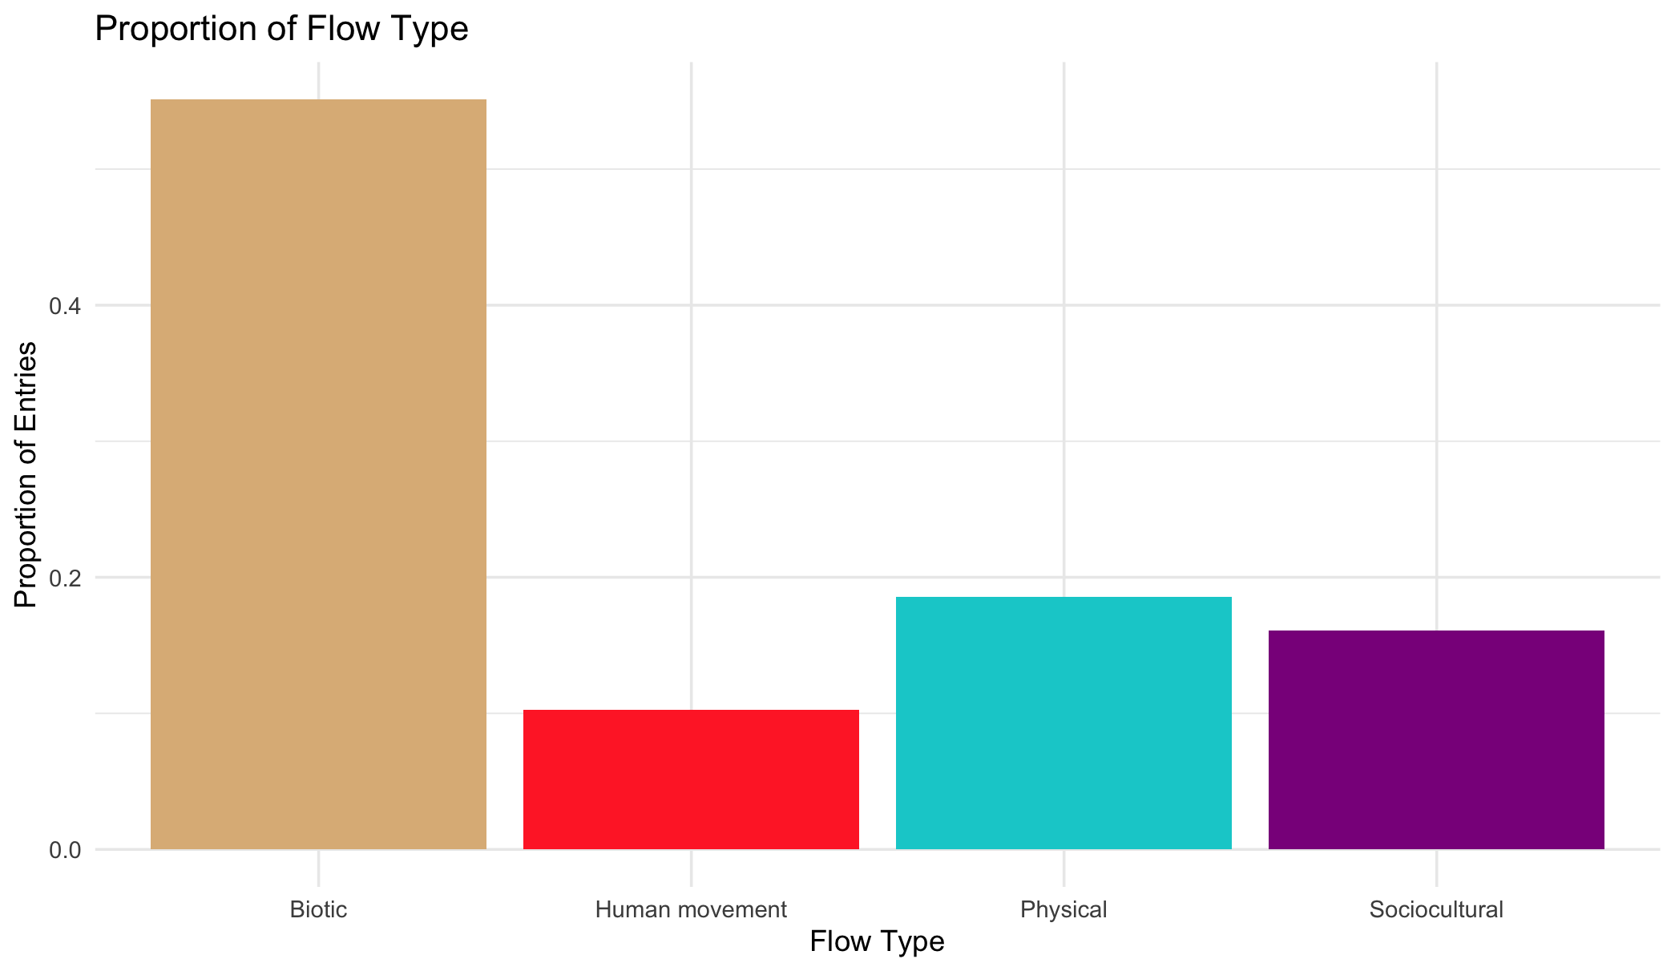

Slide 4
Multiple flows
Another.Flow. n prop
1 No 168 0.820
2 Yes 37 0.180

Slide 5
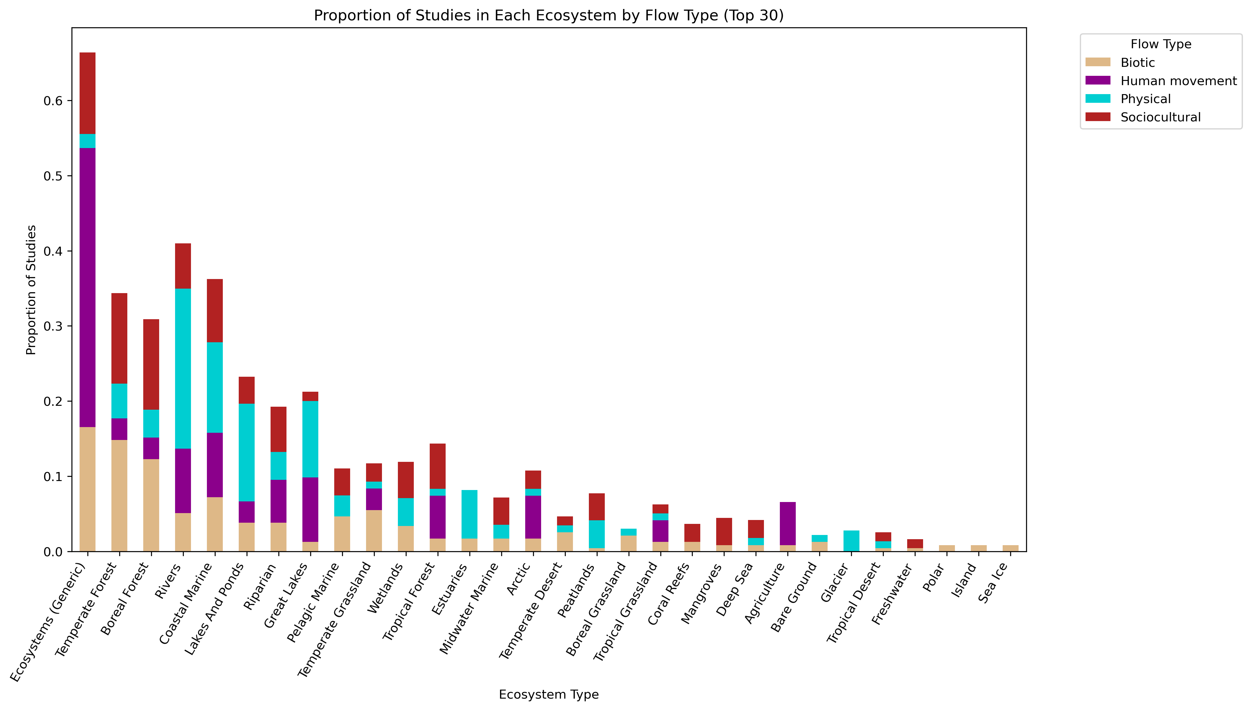
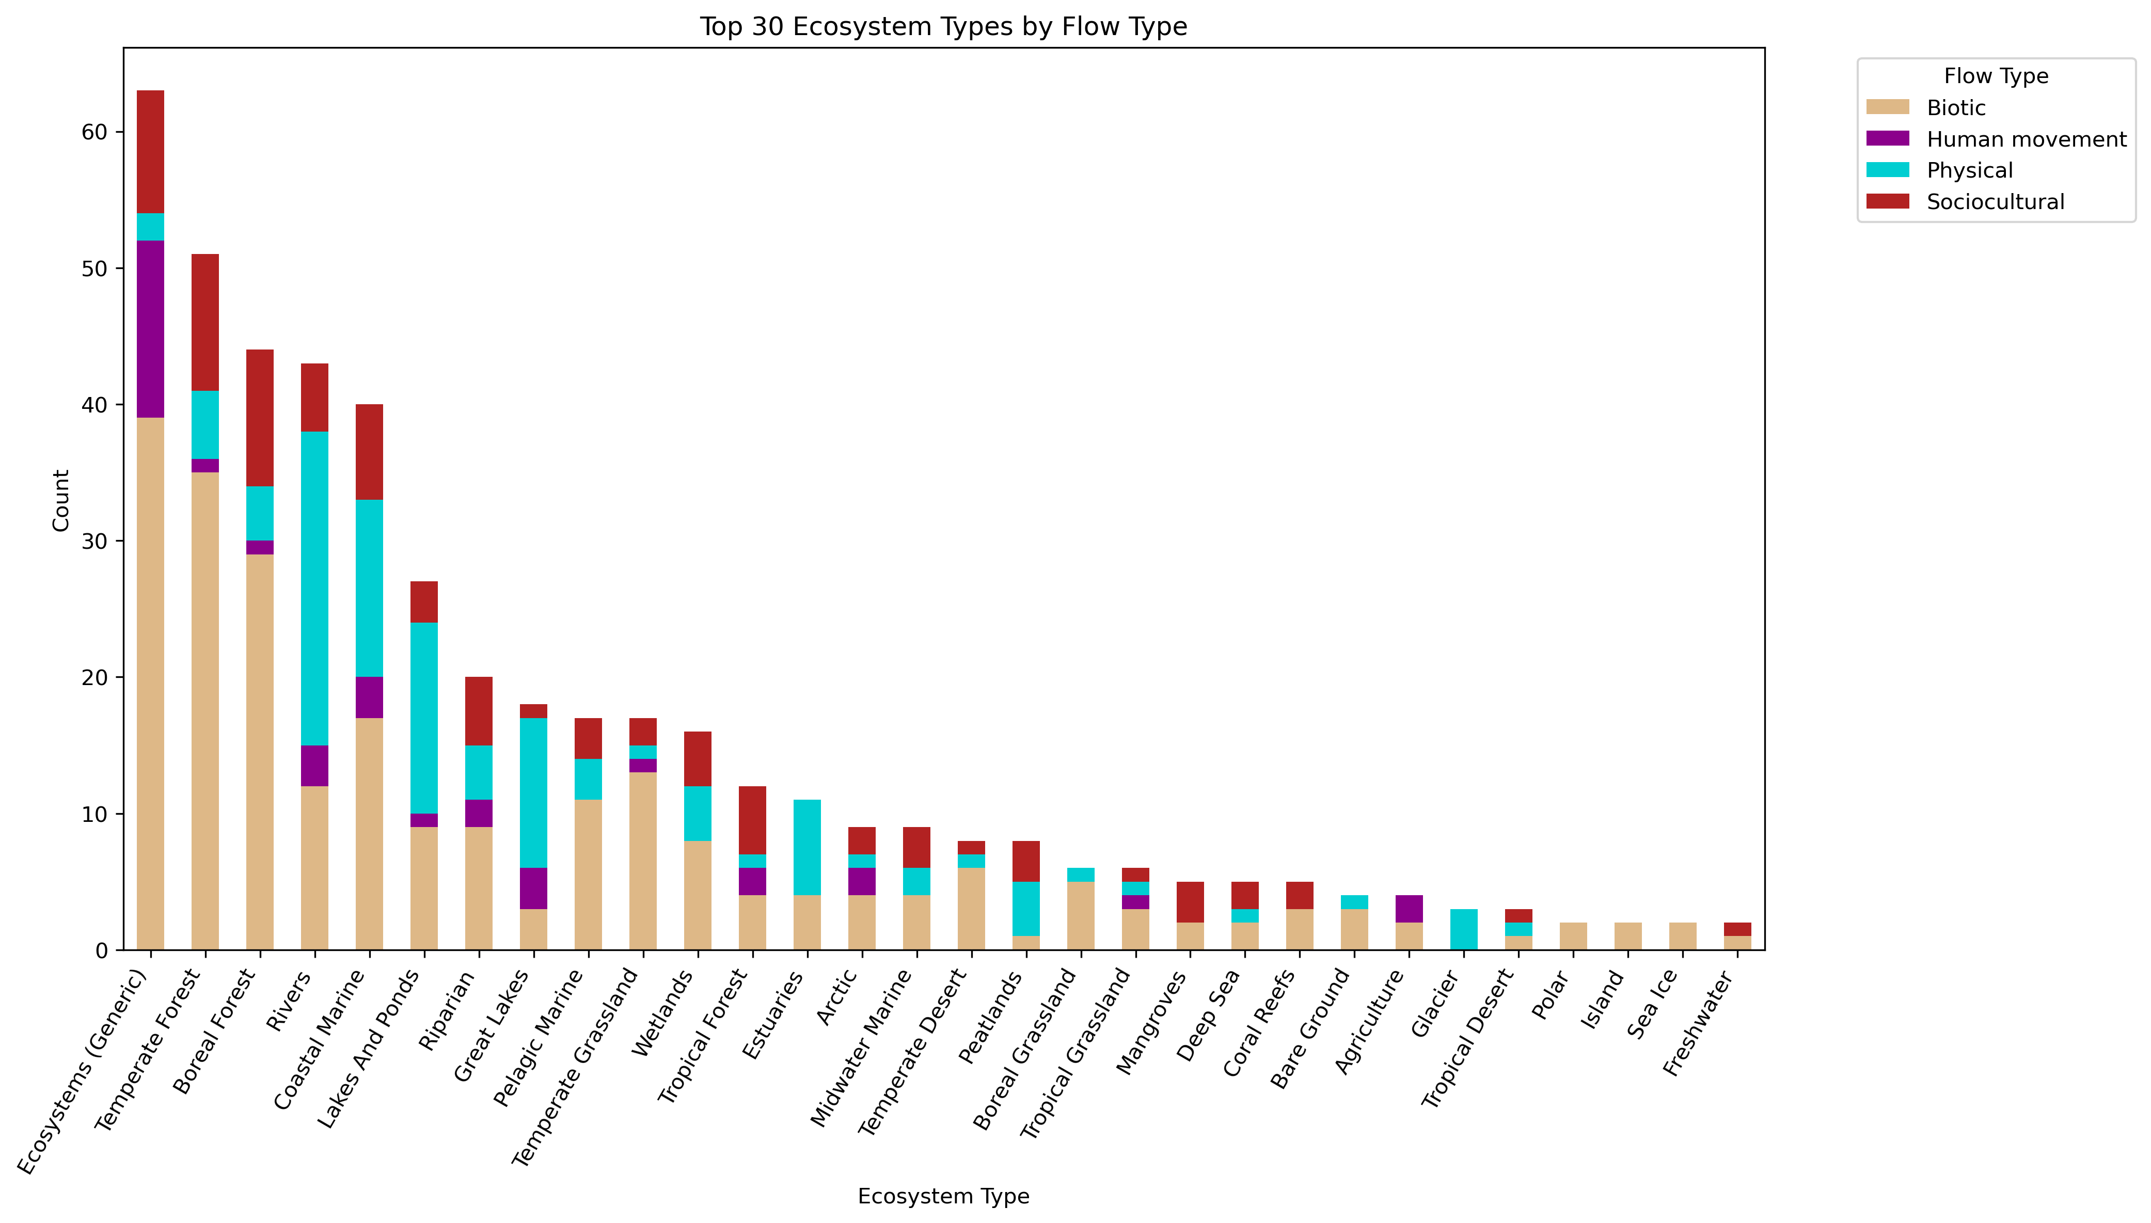

Slide 6
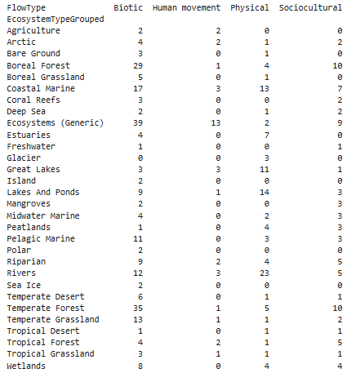
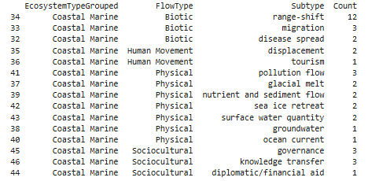

Slide 8
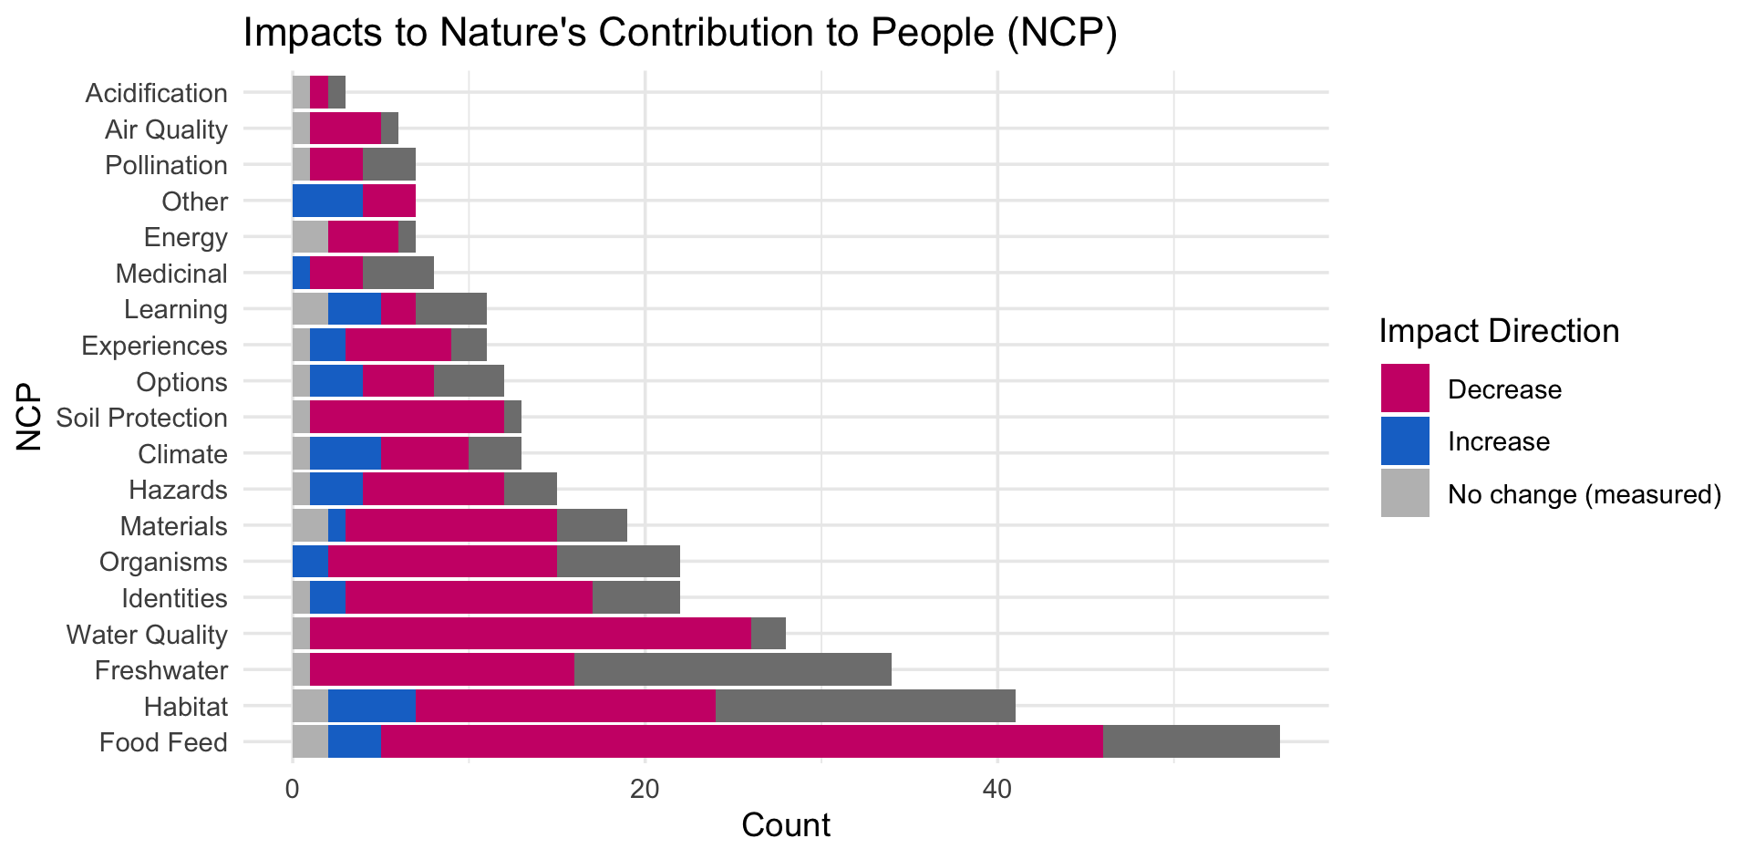

Slide 10
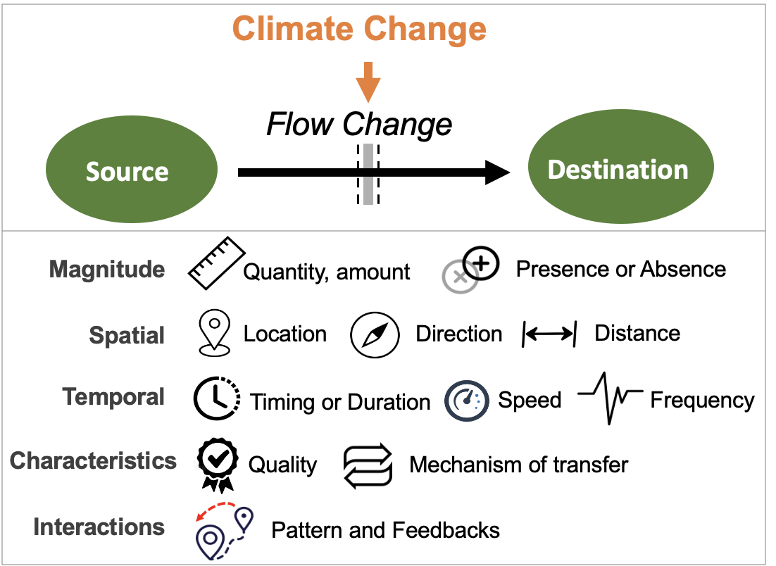
Most common paths
Climate change →

Slide 11
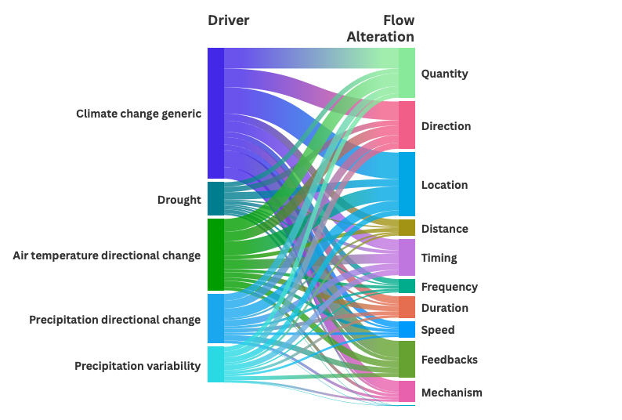

Slide 12
HWB studies count
# Cohesion Justice Other Relational Welfare
# 18 21 7 31 76

Slide 13
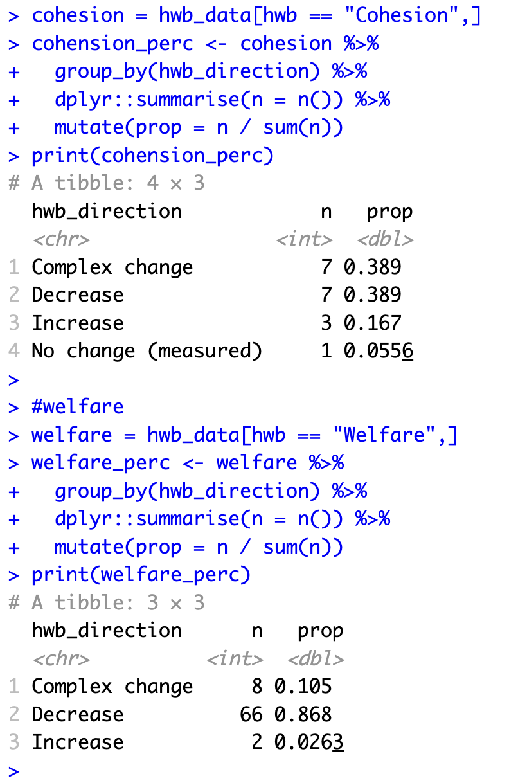
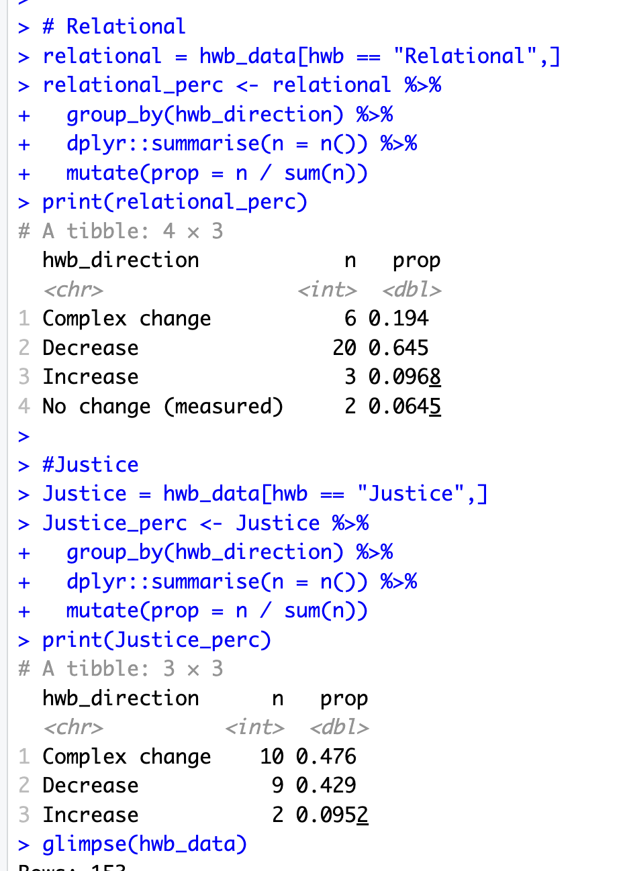

Slide 14
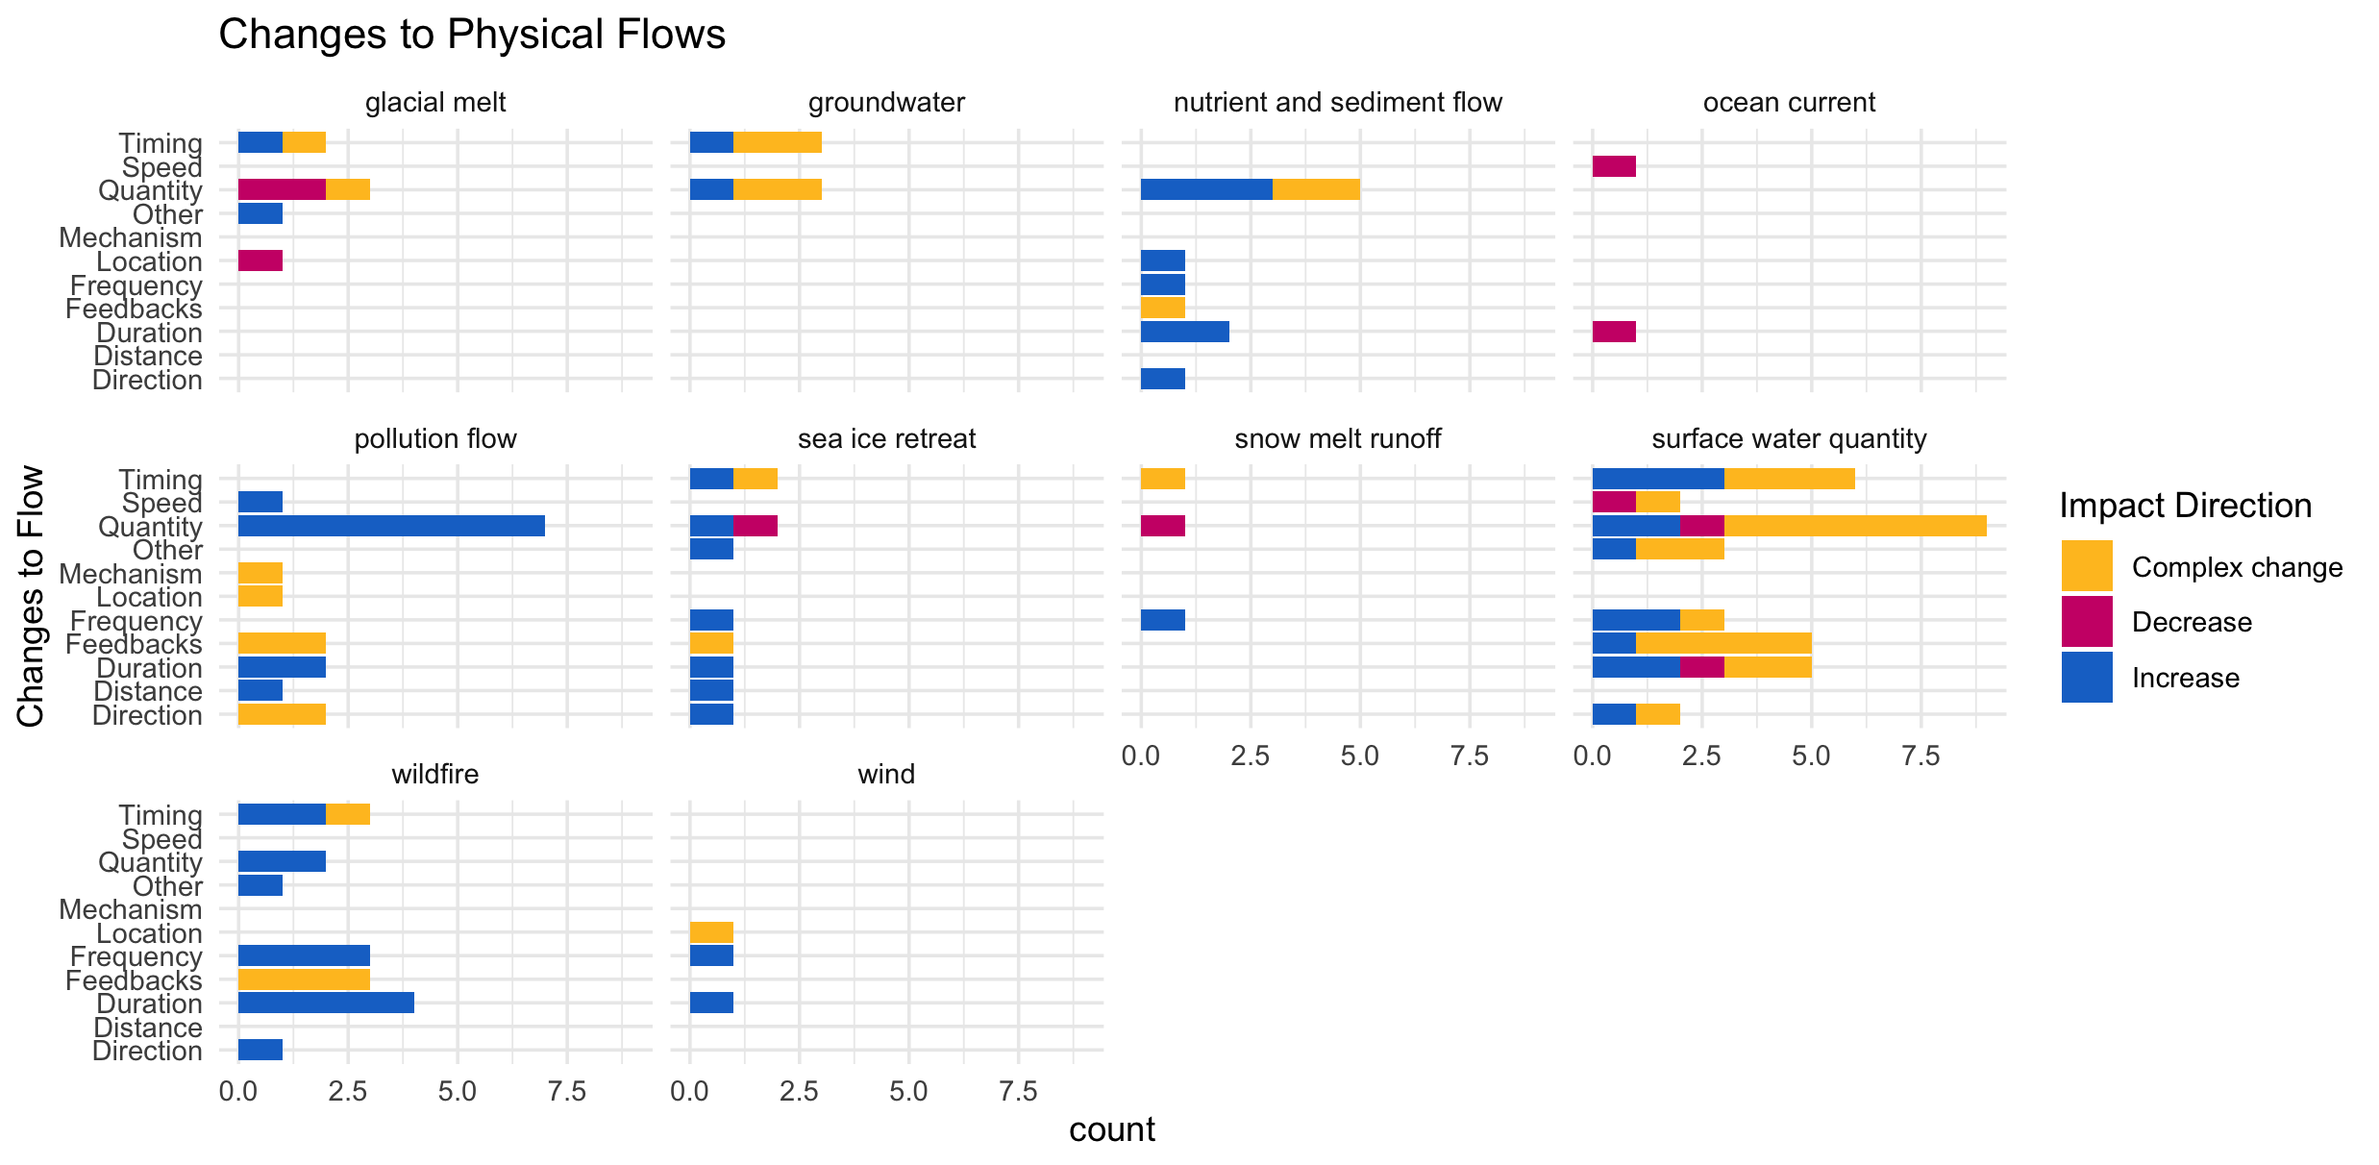

Slide 15
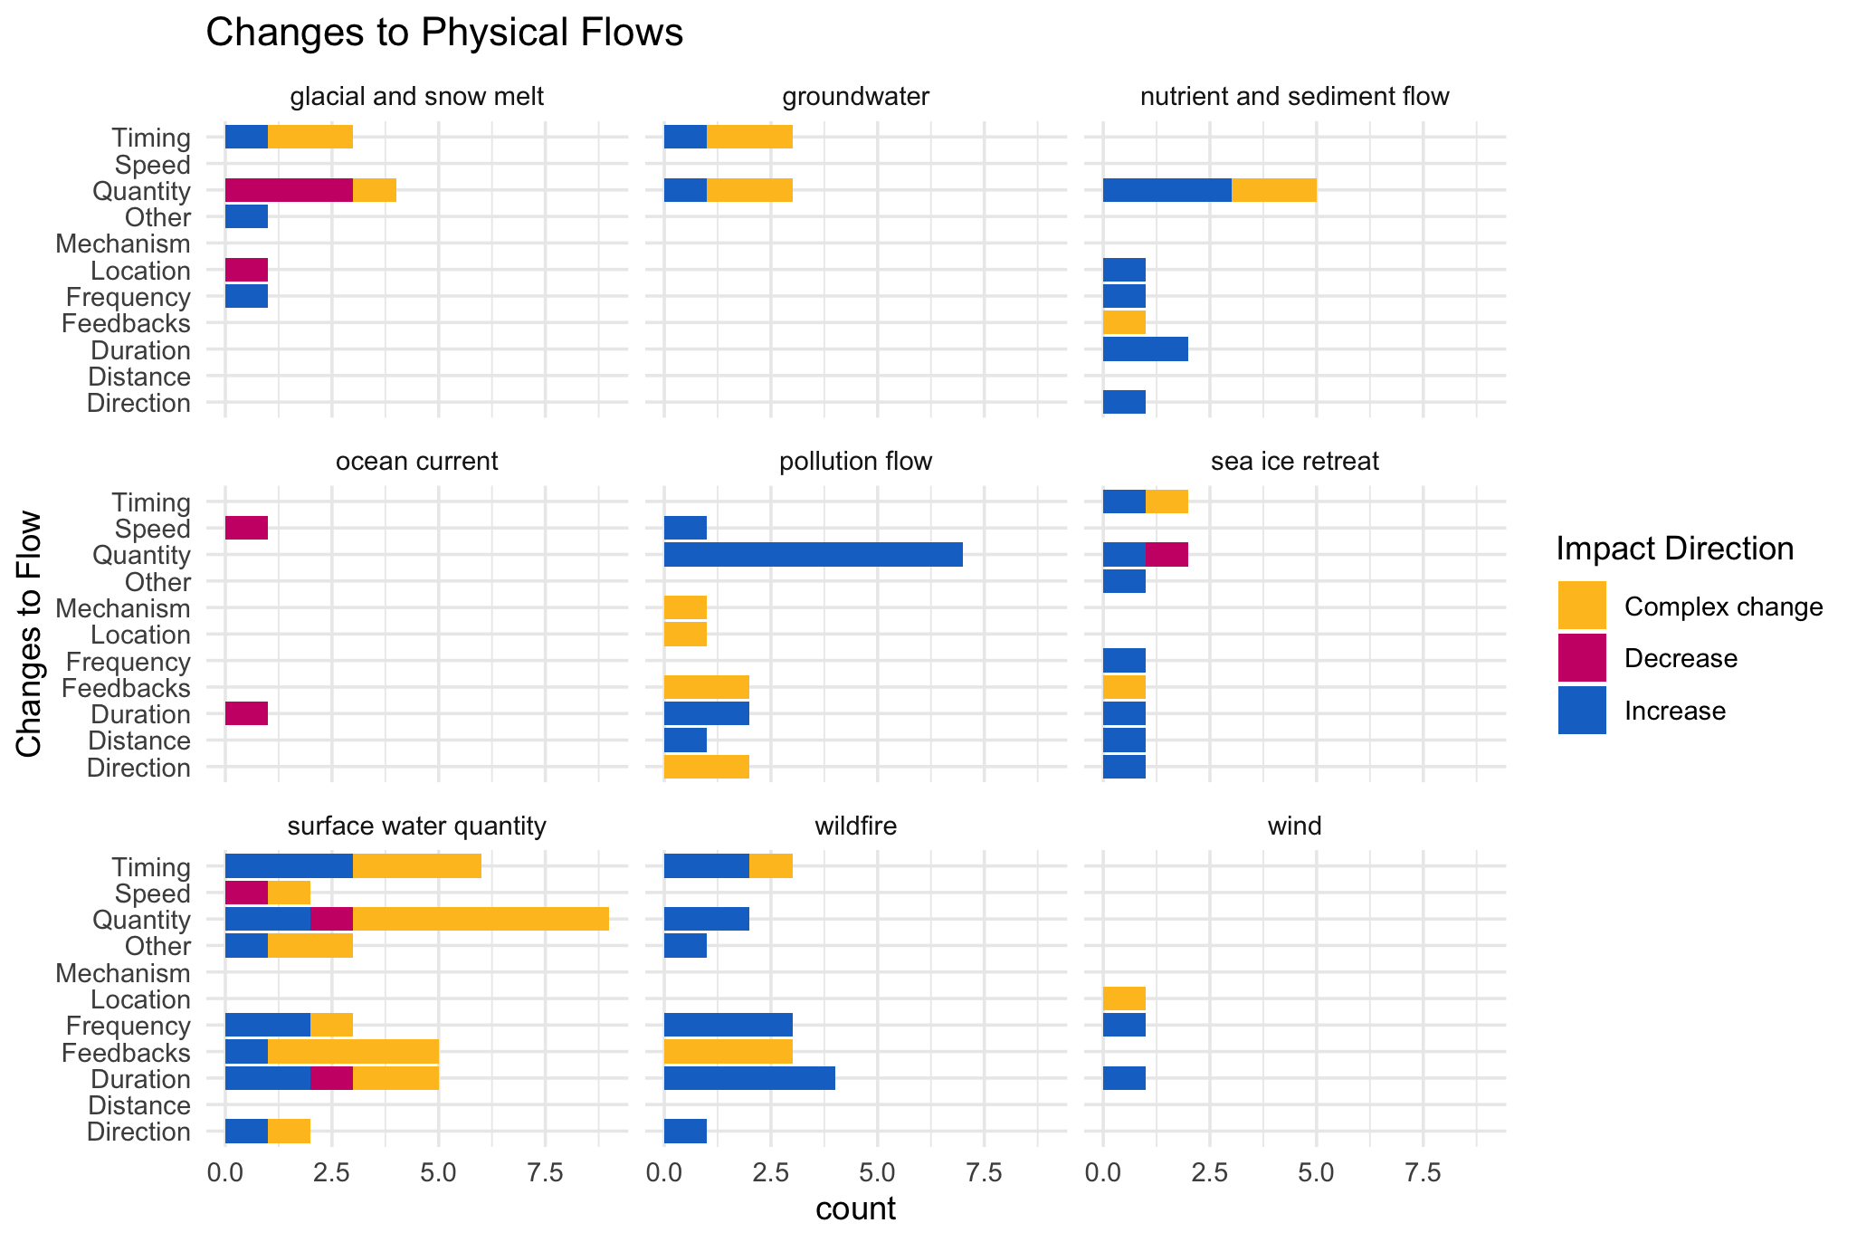

Slide 16
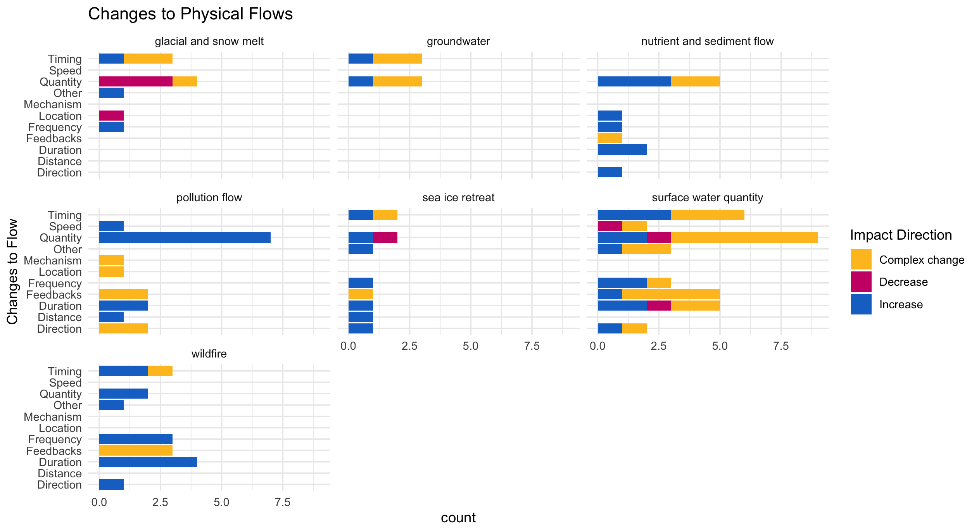

Slide 17
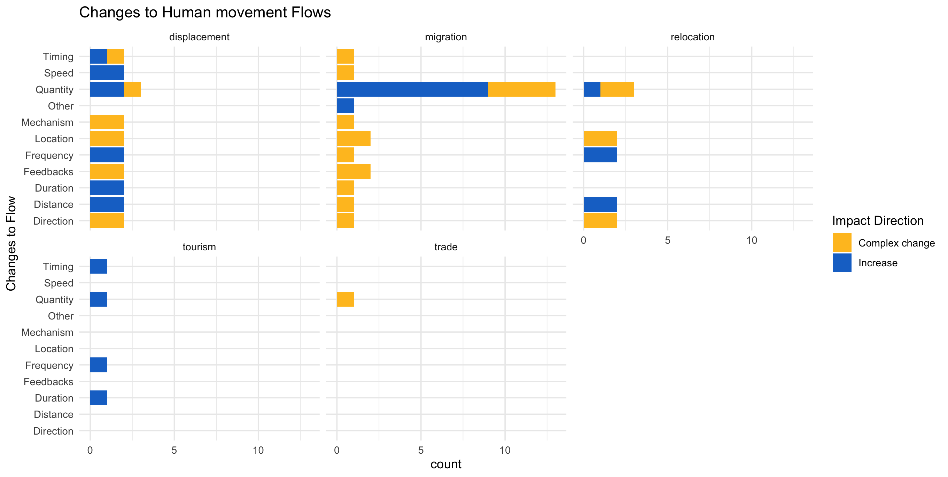

Slide 18
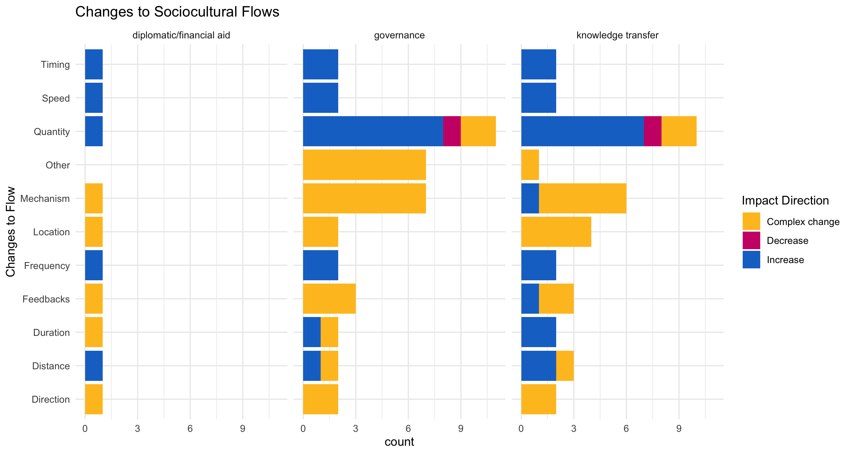

Slide 19
hwb_direction n prop
<chr> <int> <dbl>
1 Complex change 8 0.105
2 Decrease 66 0.868
3 Increase 2 0.0263

Slide 20
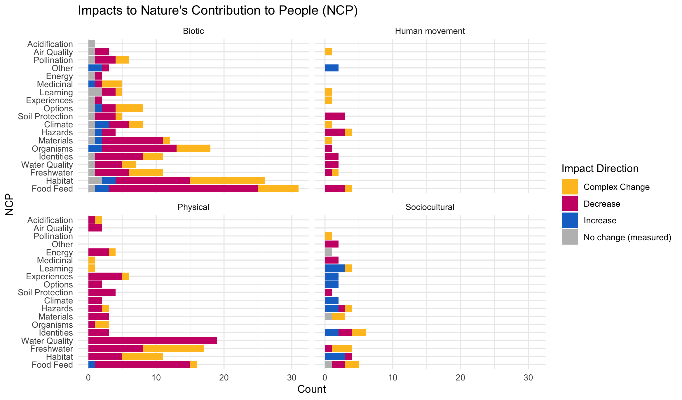

Slide 21
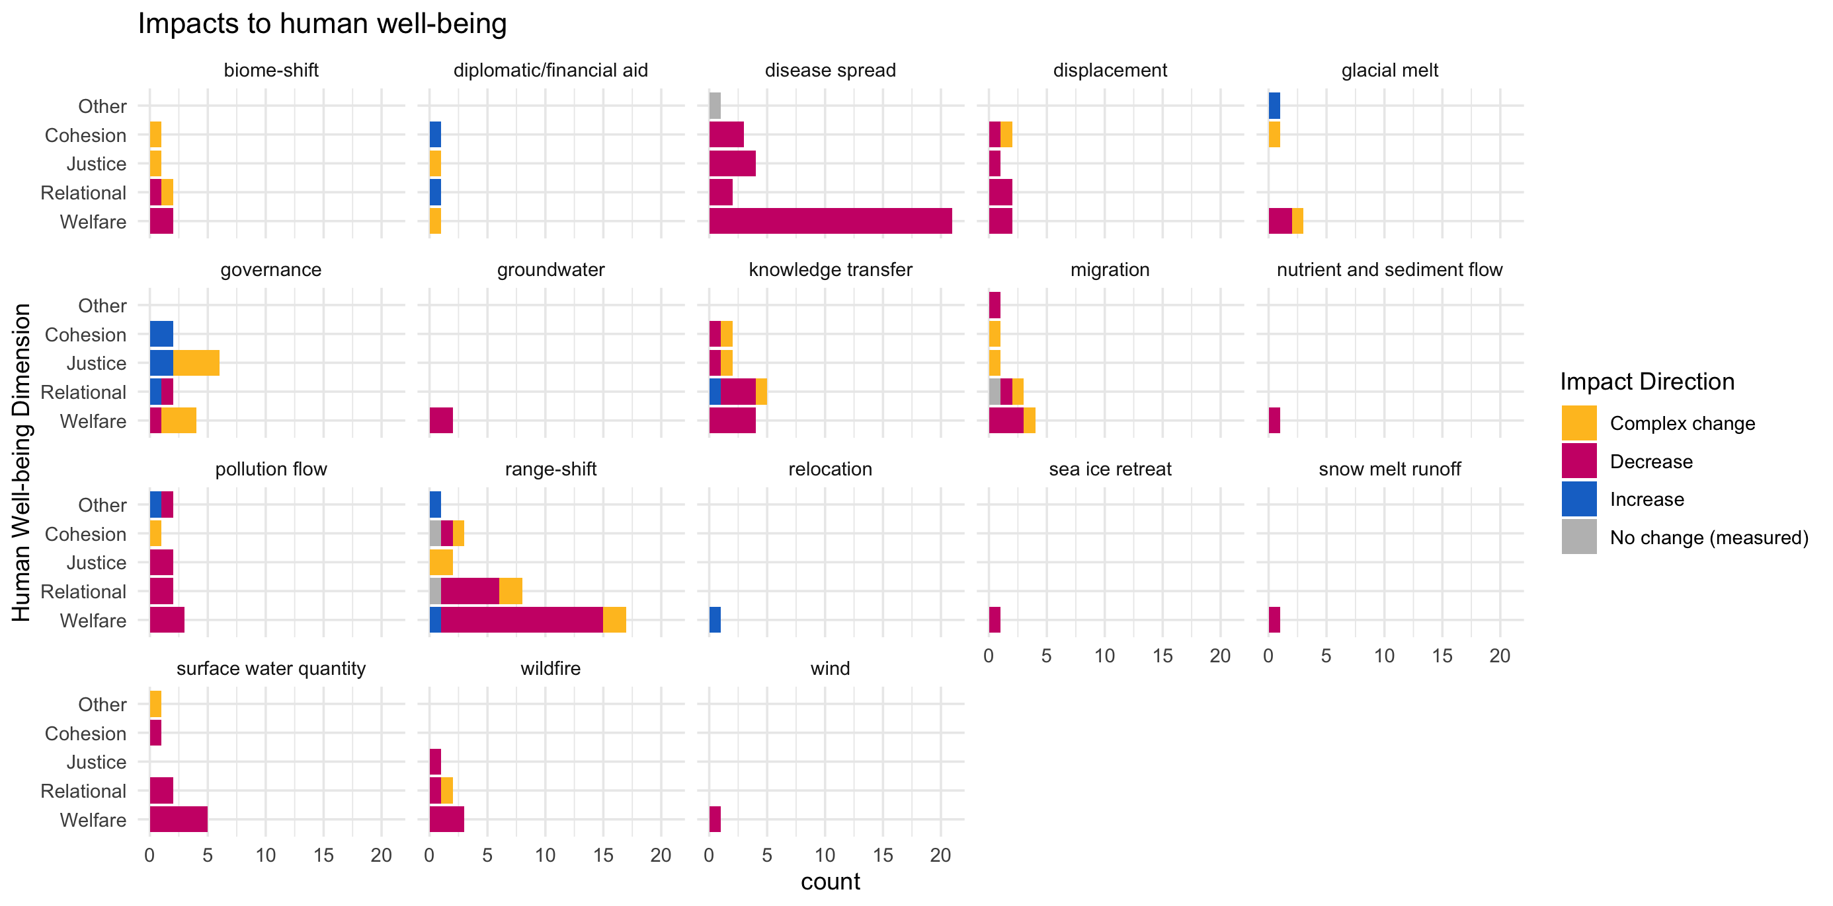

Slide 22
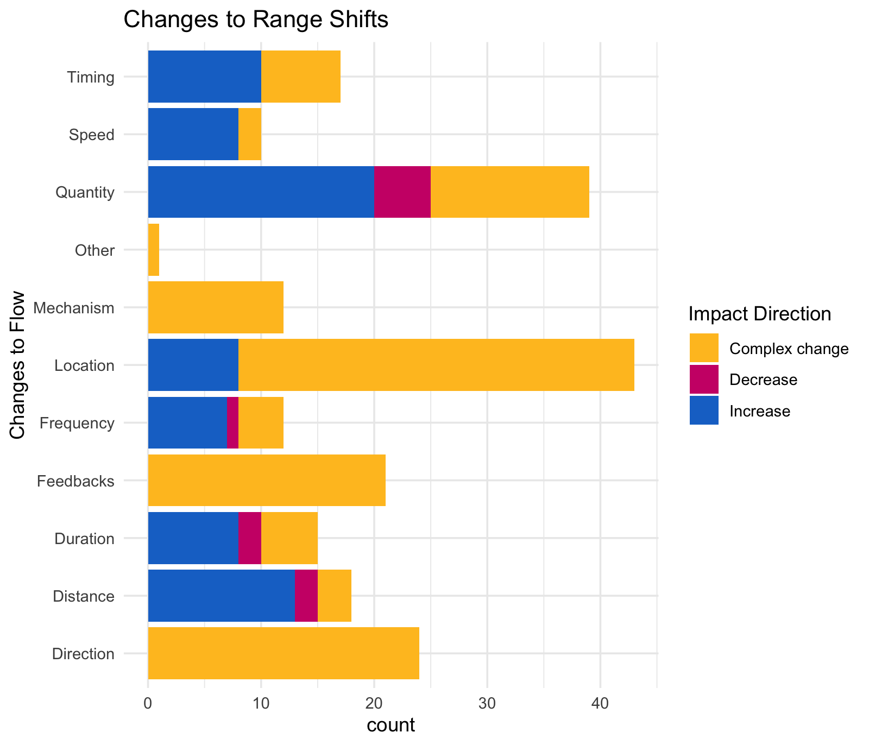

Slide 23
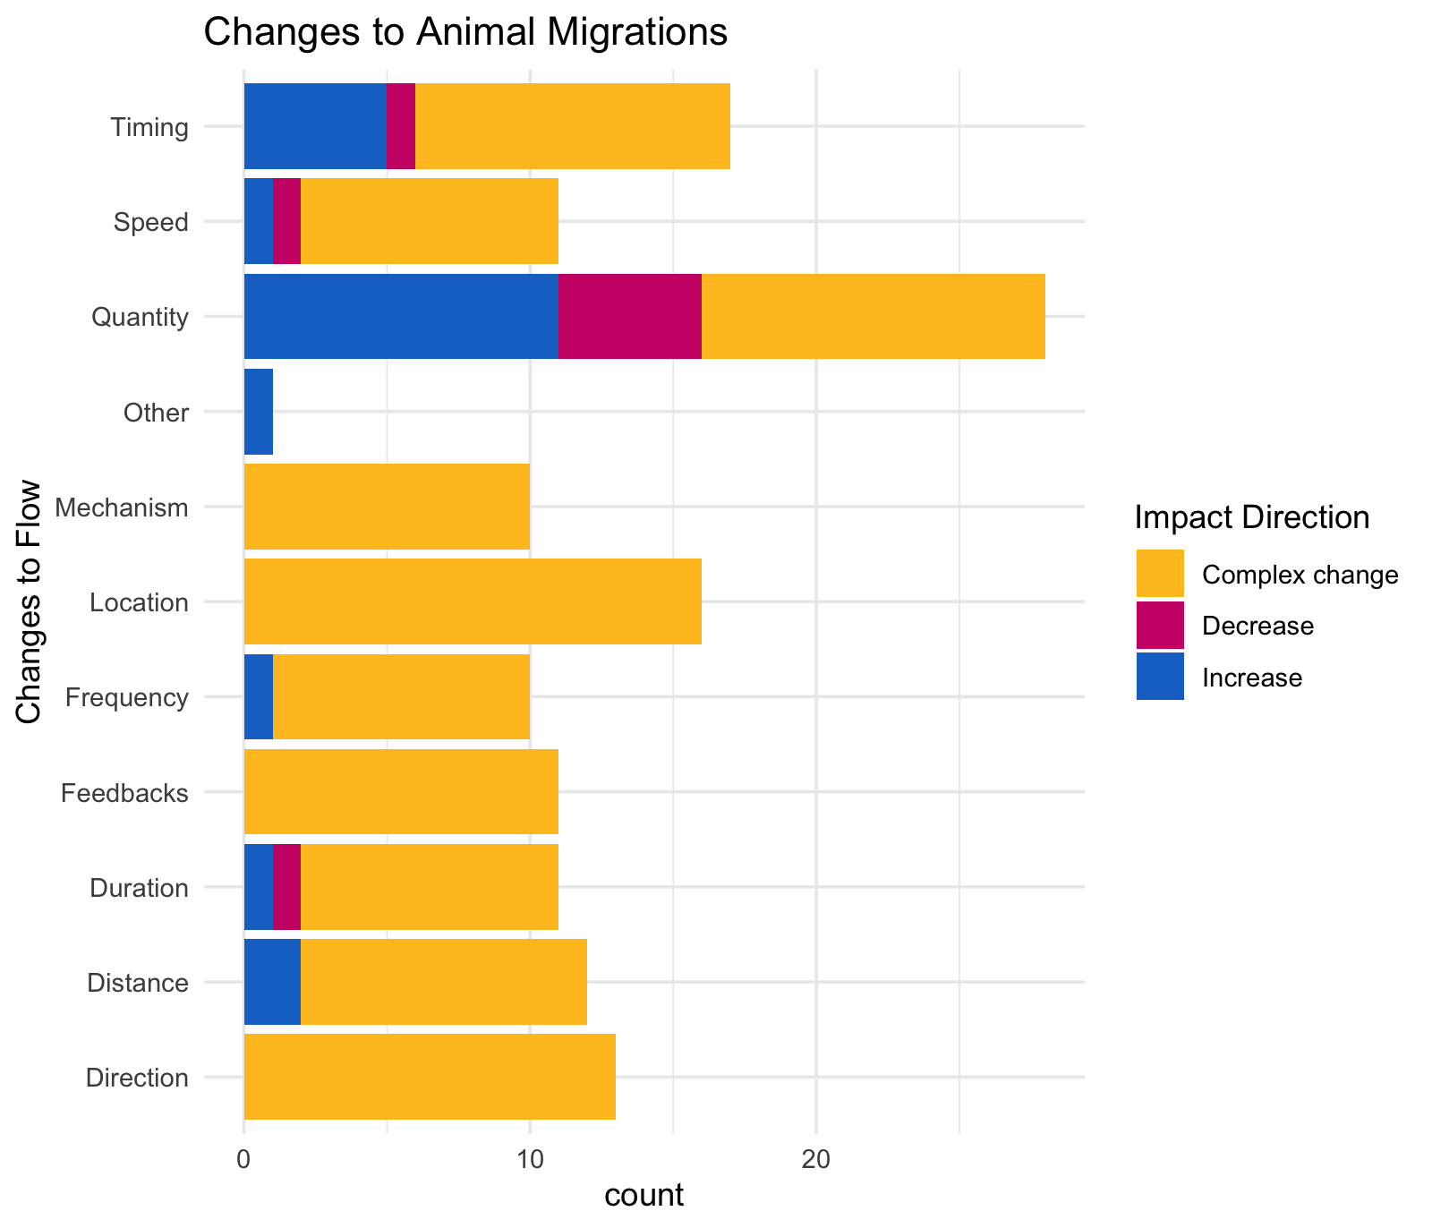

Slide 24
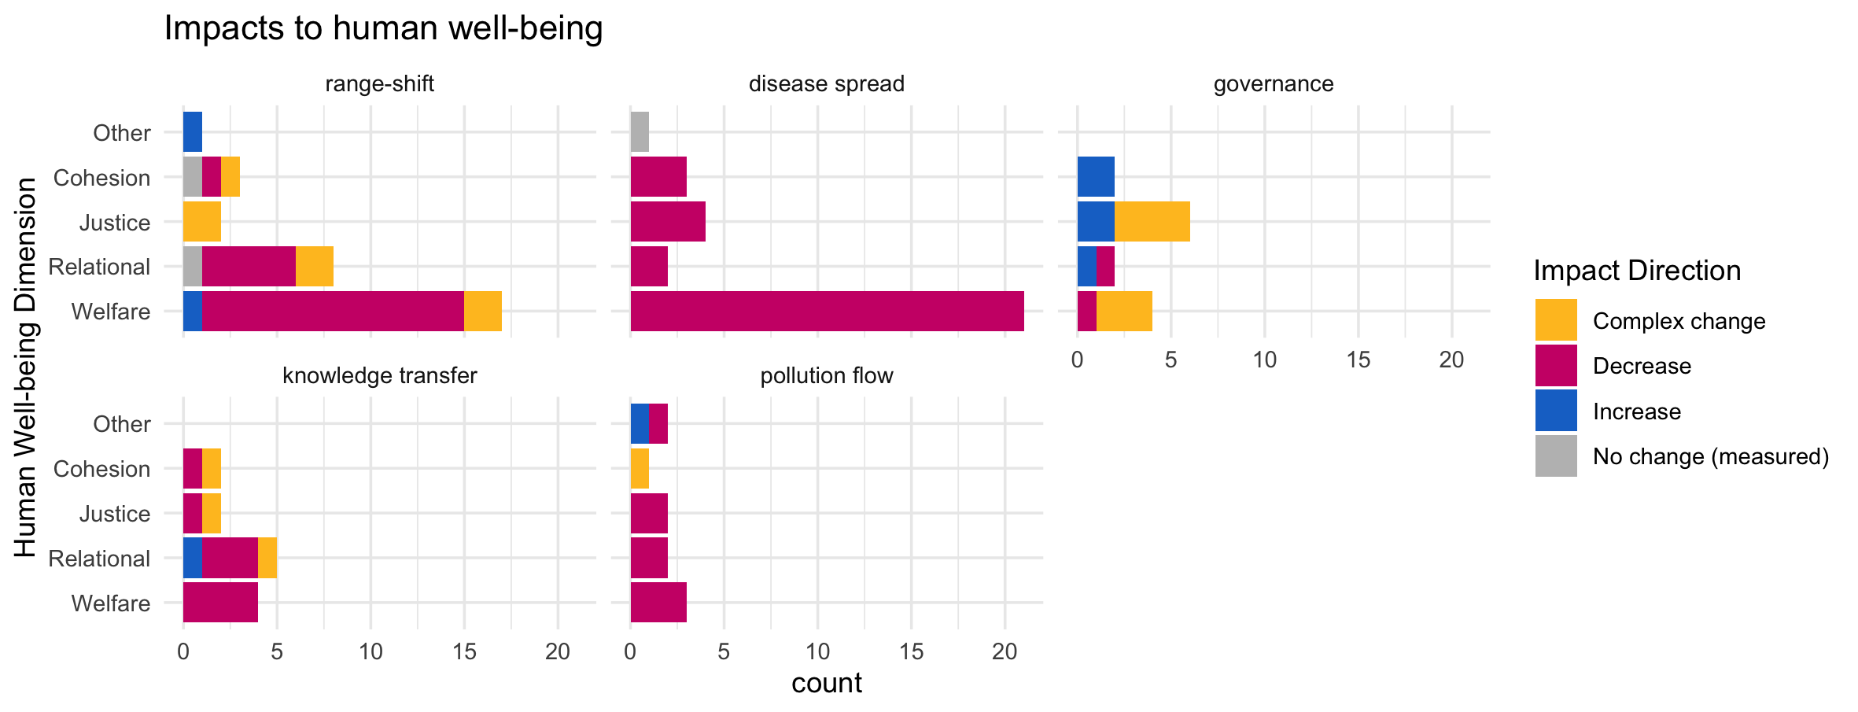

Slide 25
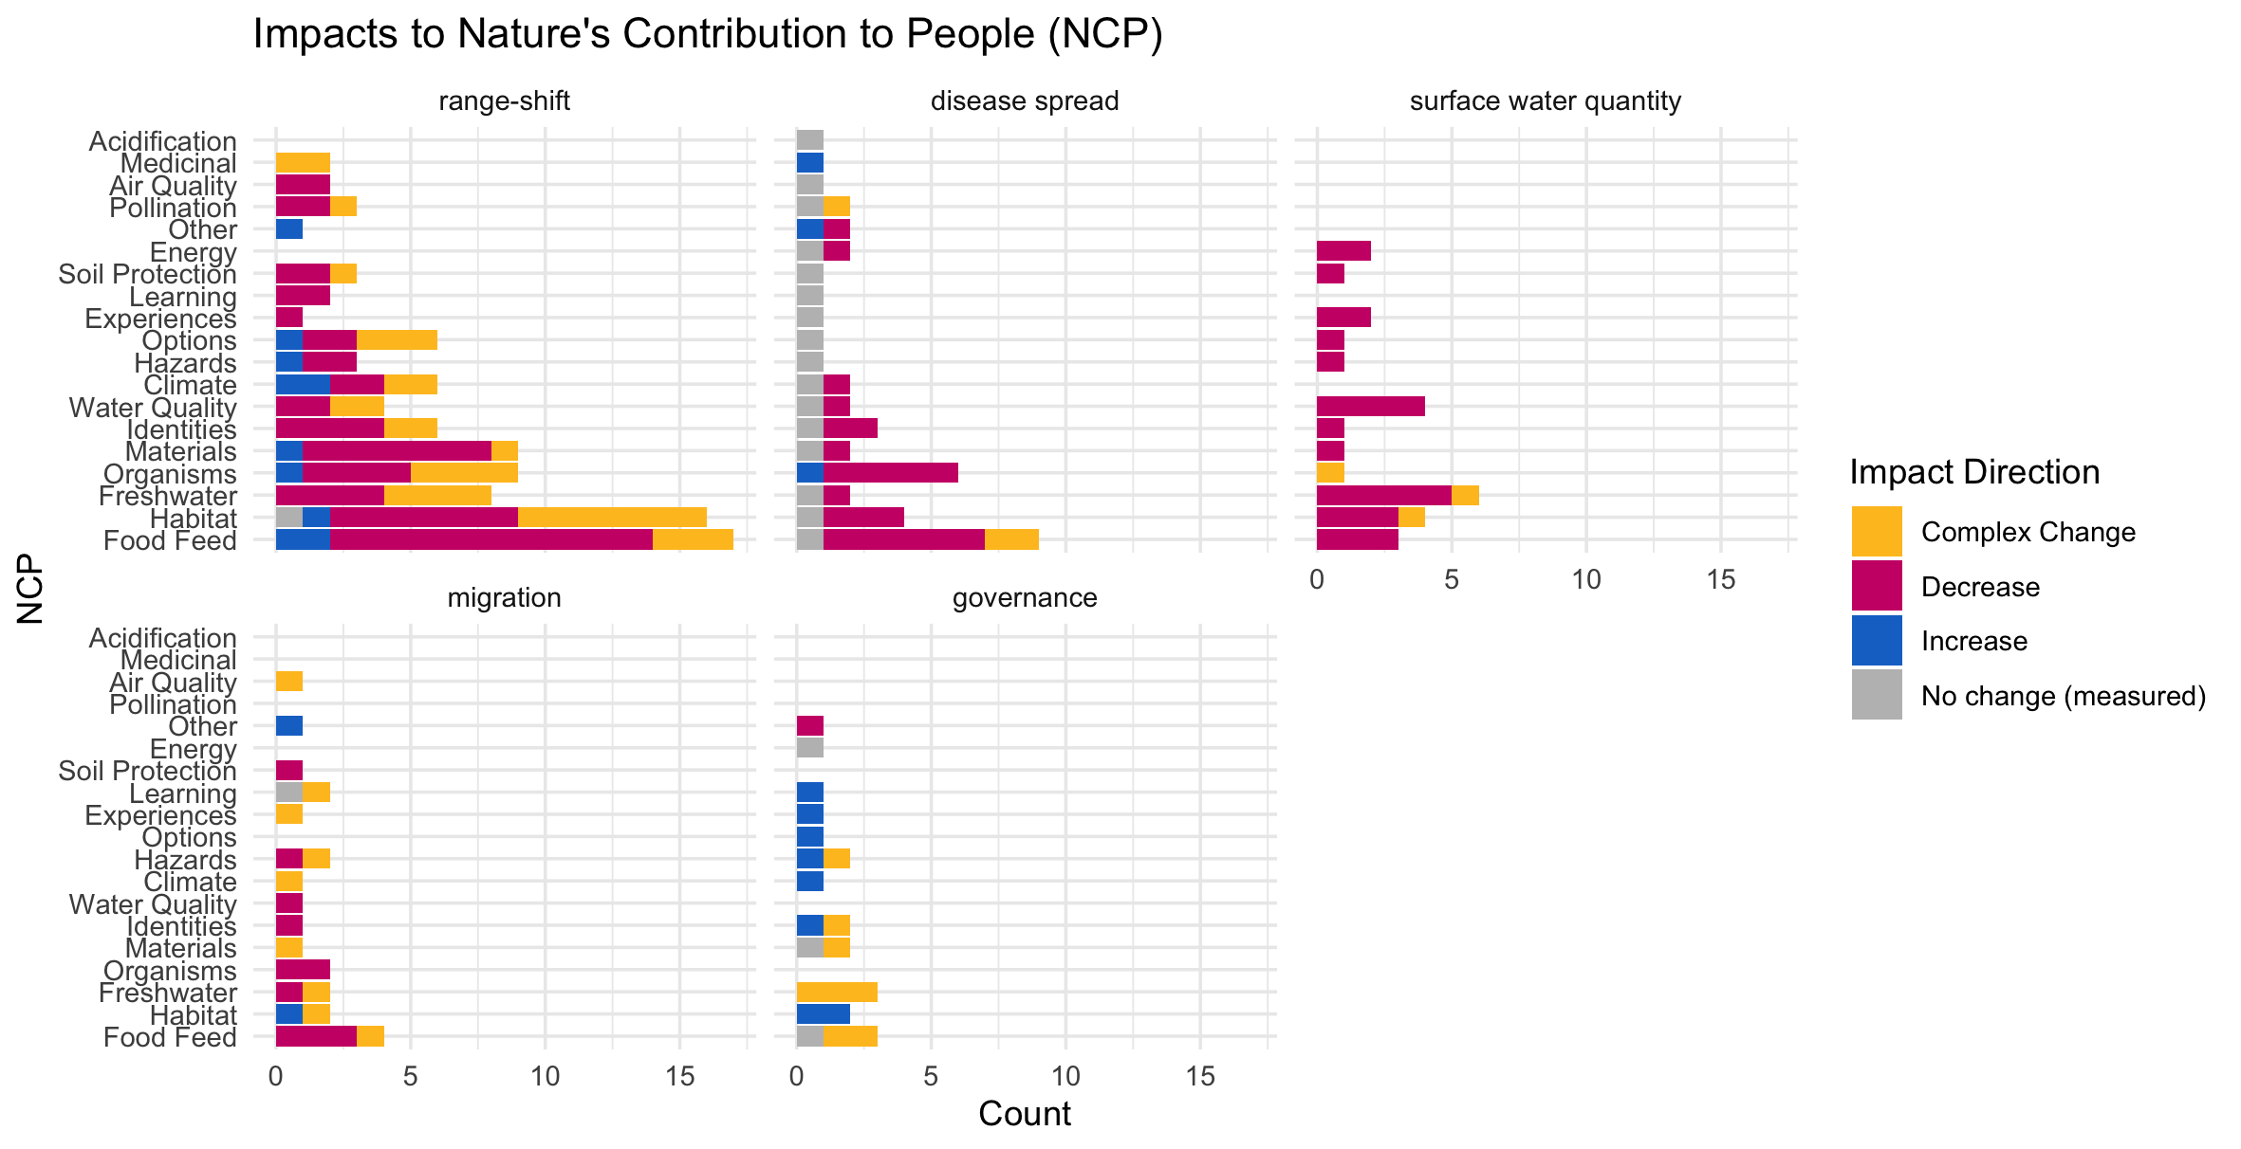

Slide 26
OLDER:

Slide 28
At least 5 entries – top – to get stats on % of entries or papers on these:

Slide 29
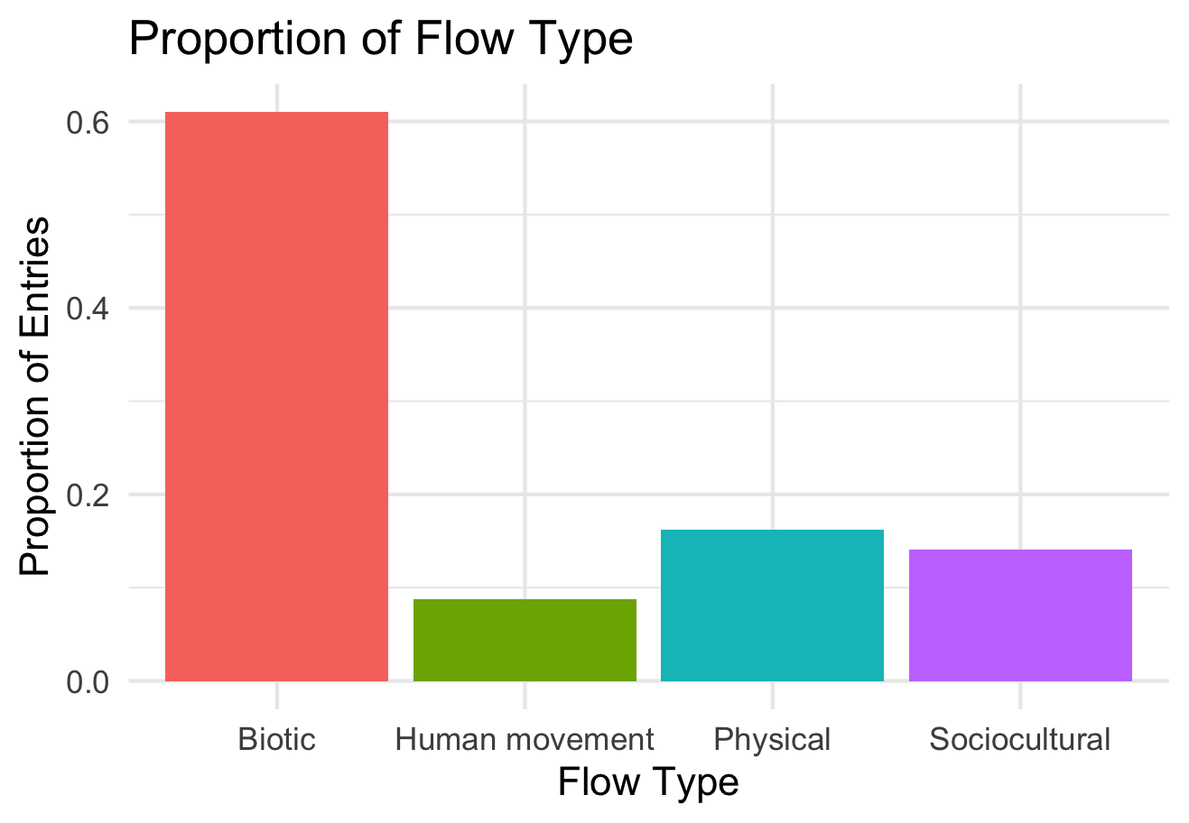

Slide 30
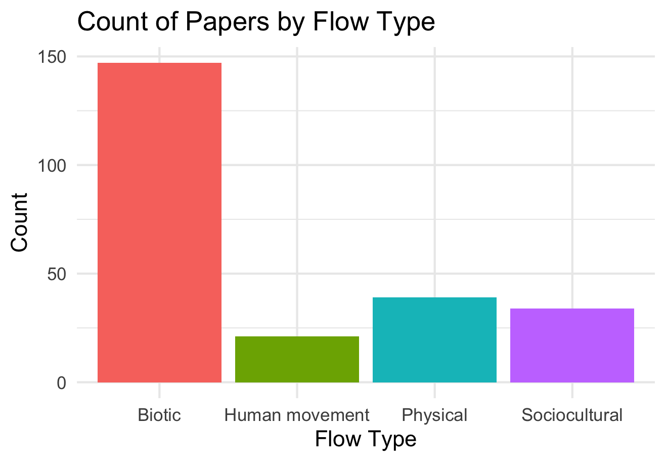

Slide 31
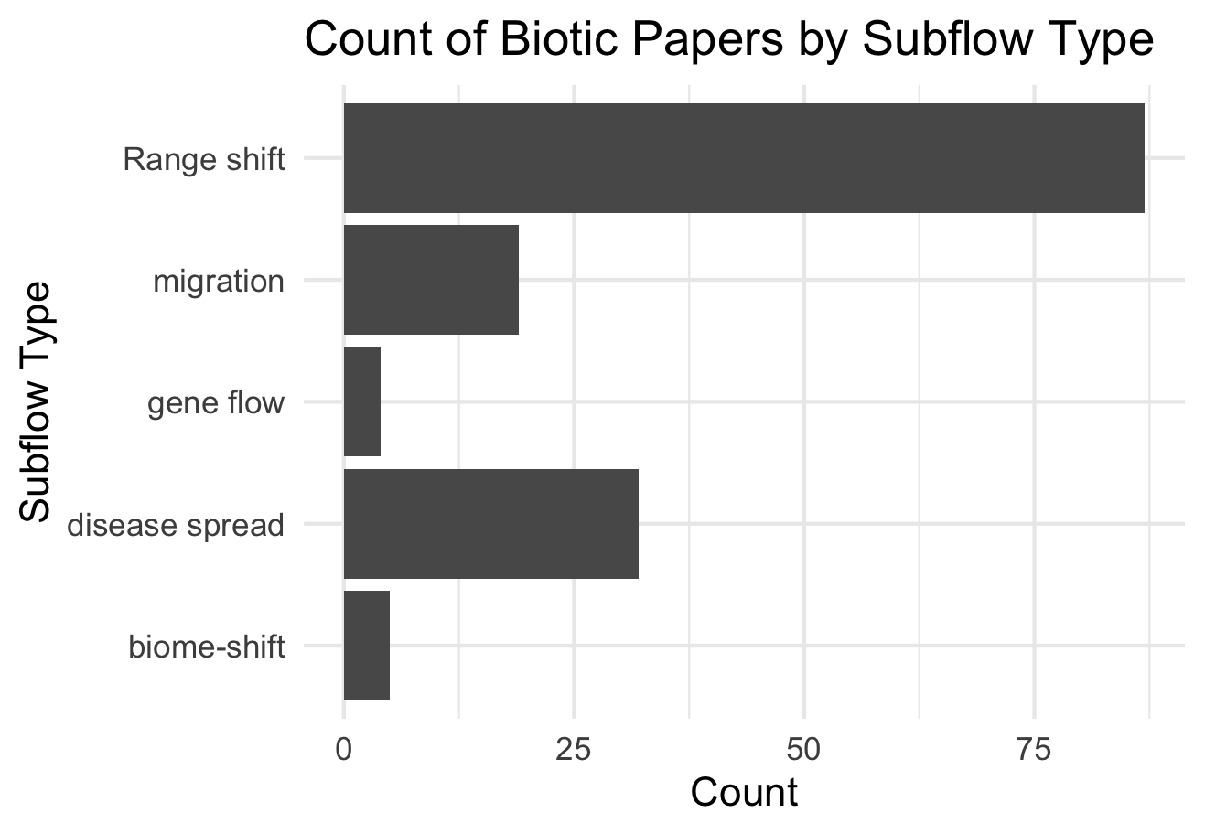

Slide 32
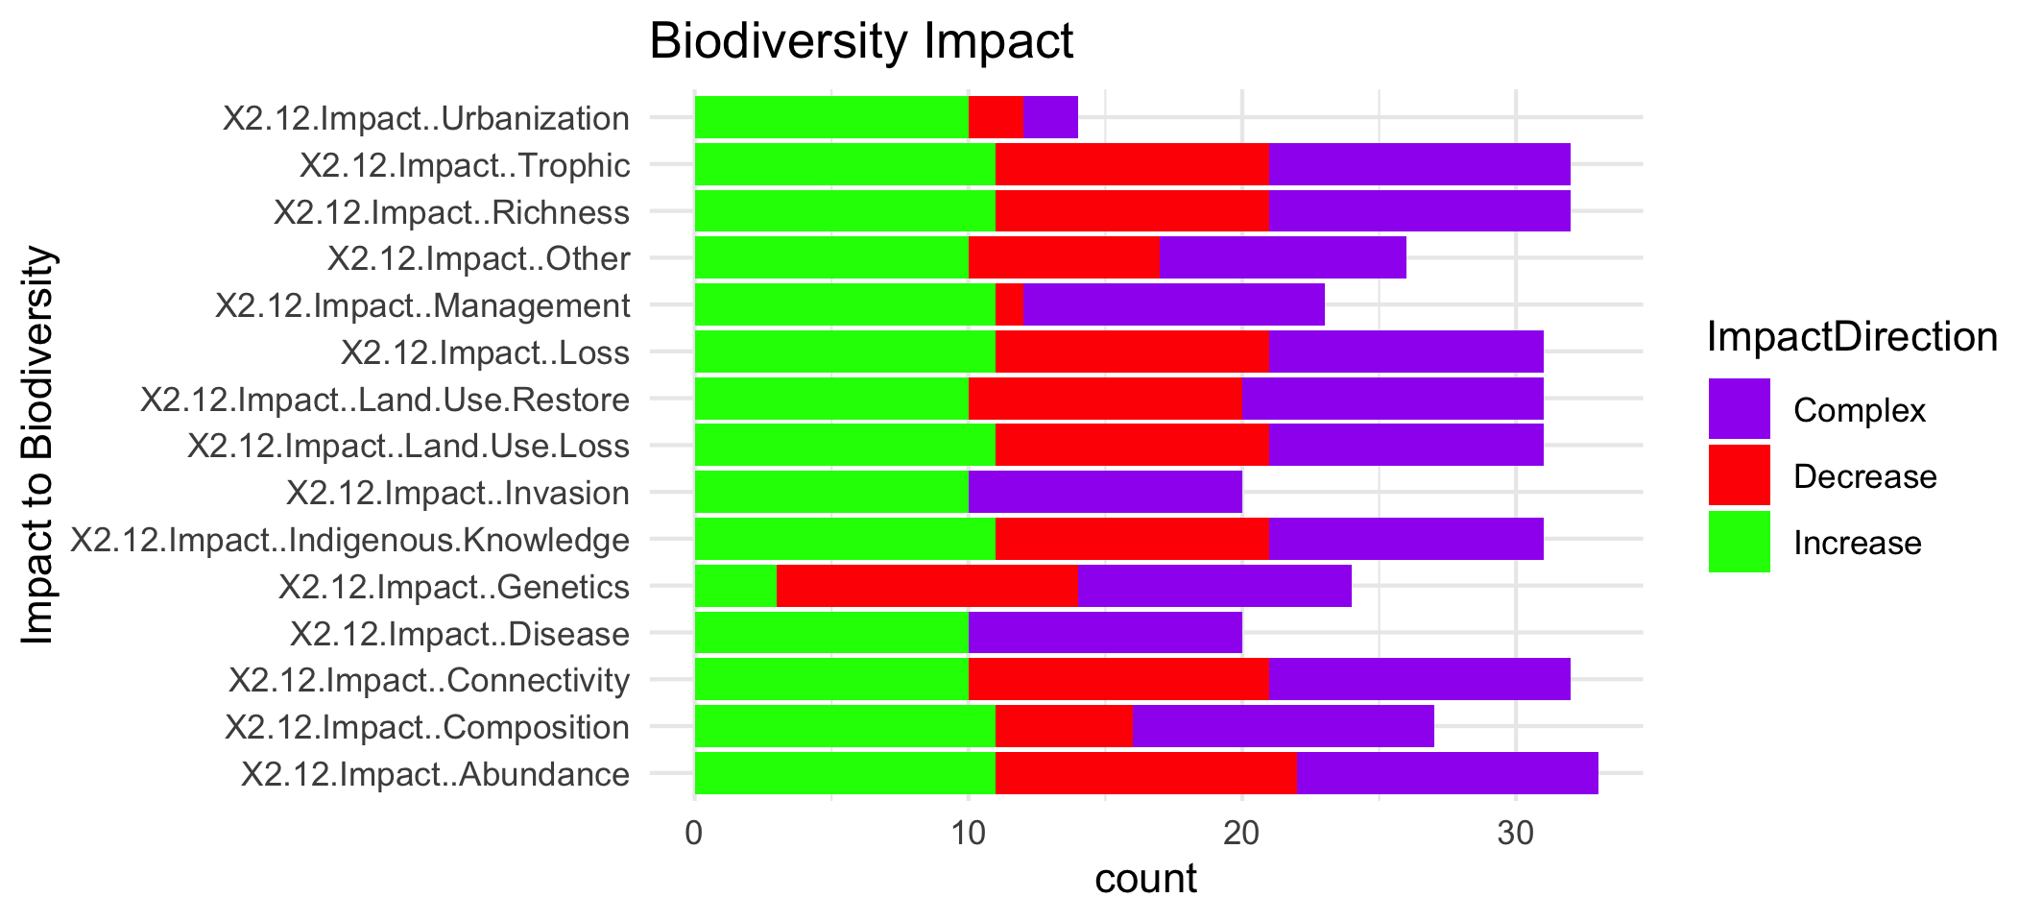

Slide 34
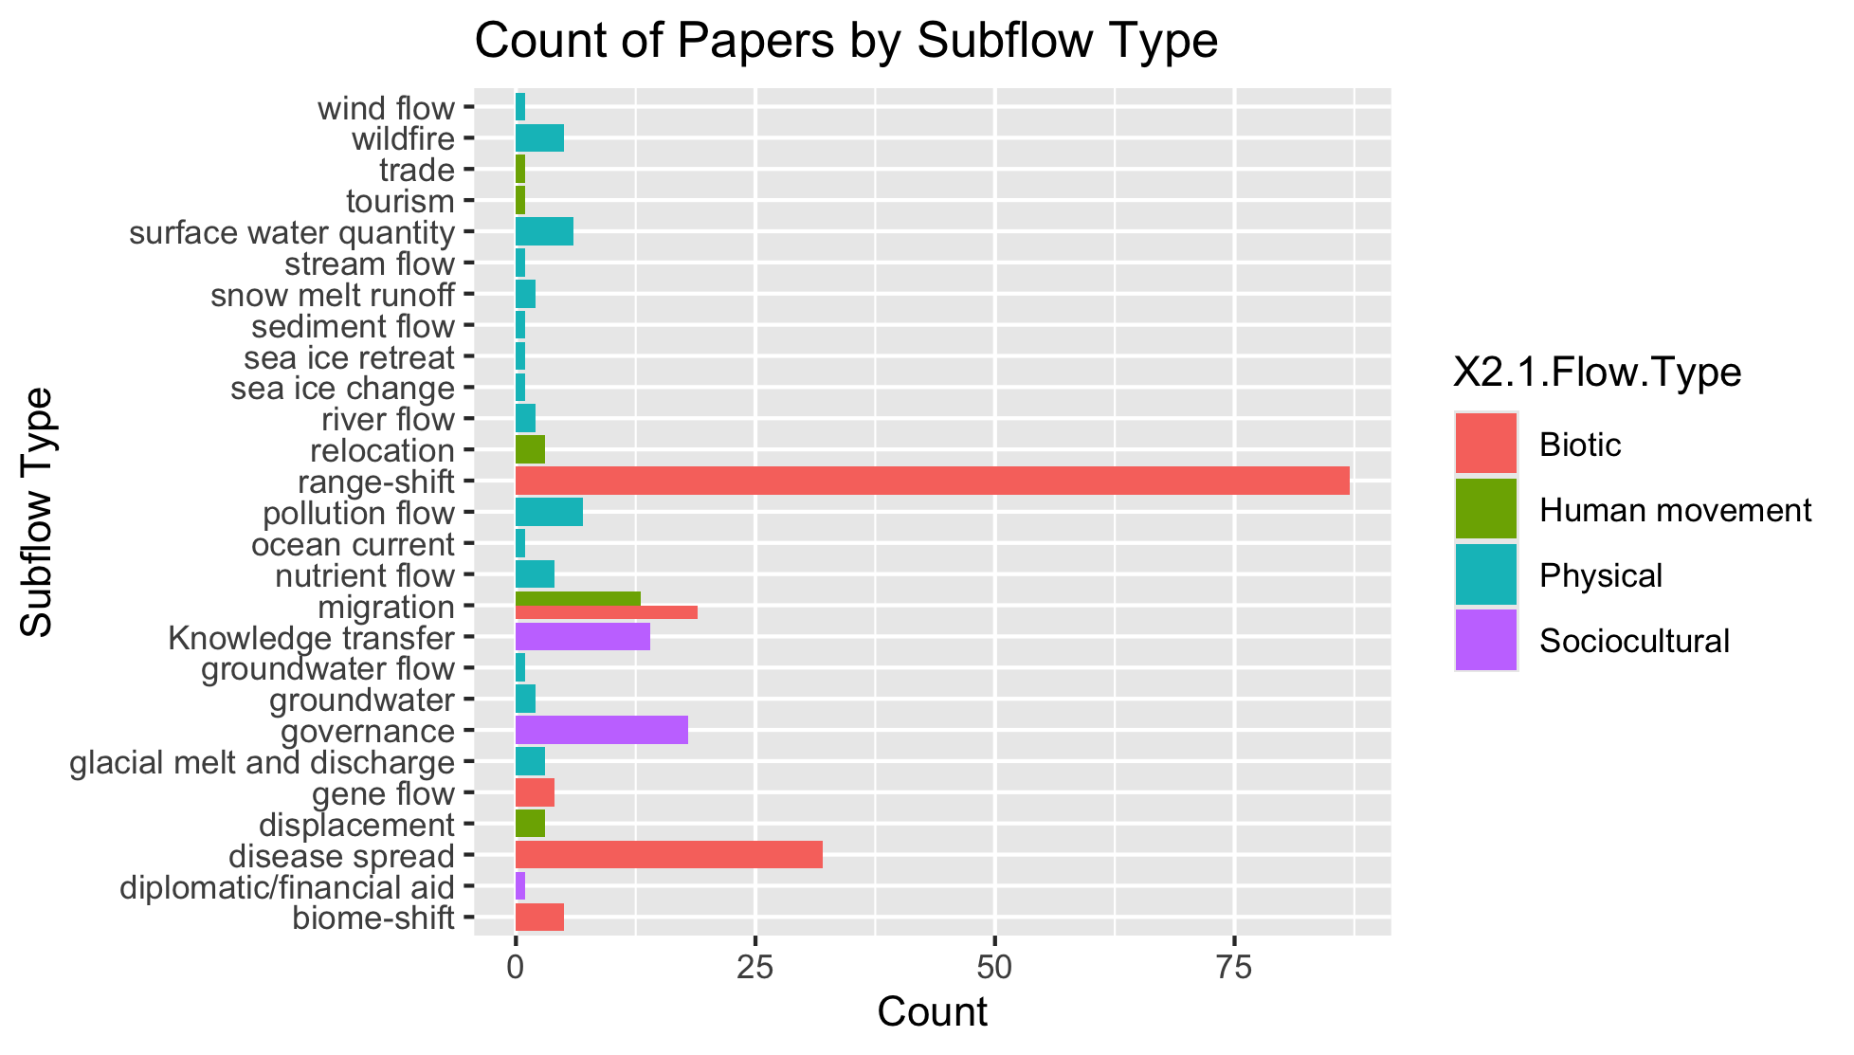
To group physical flow papers

Slide 35
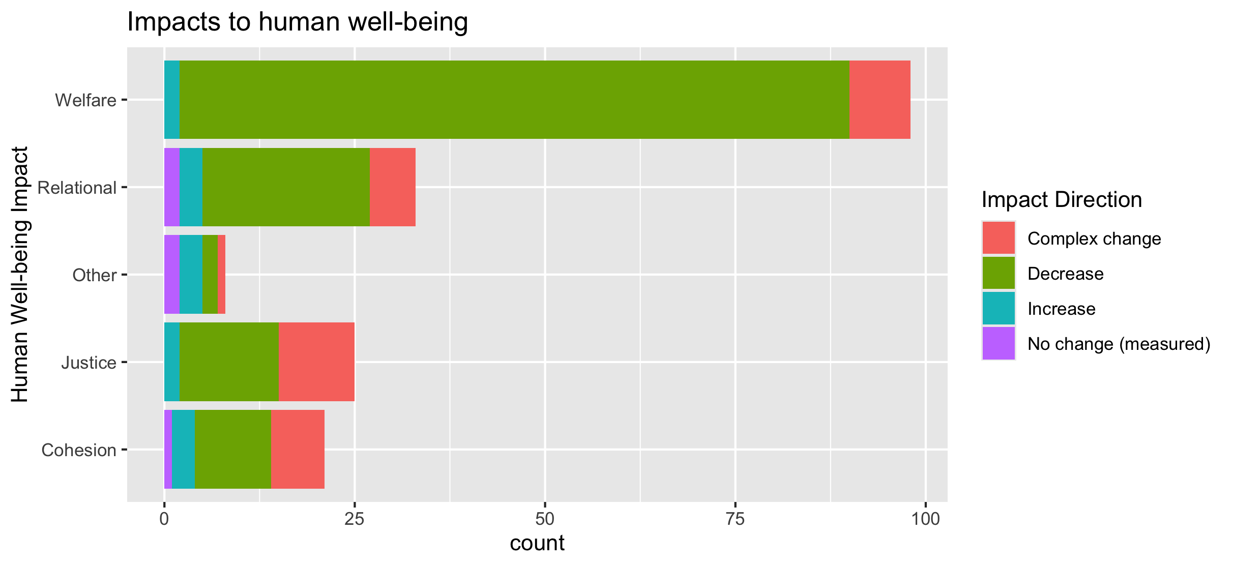
To align direction colors with final color pallet

Slide 36
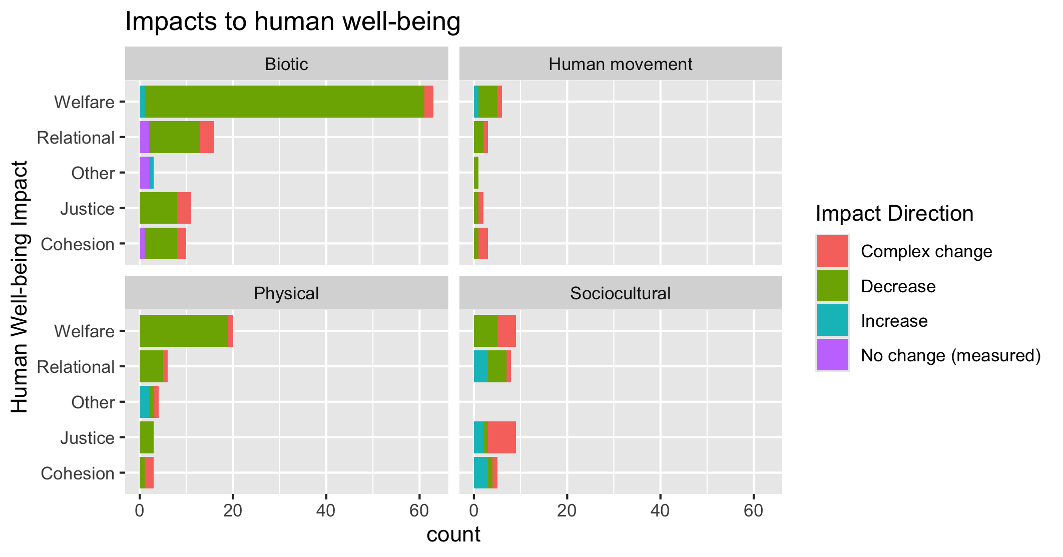
To align direction colors with final color pallet

Slide 37
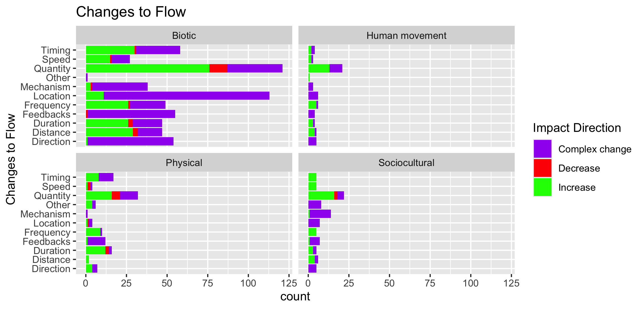

Slide 38
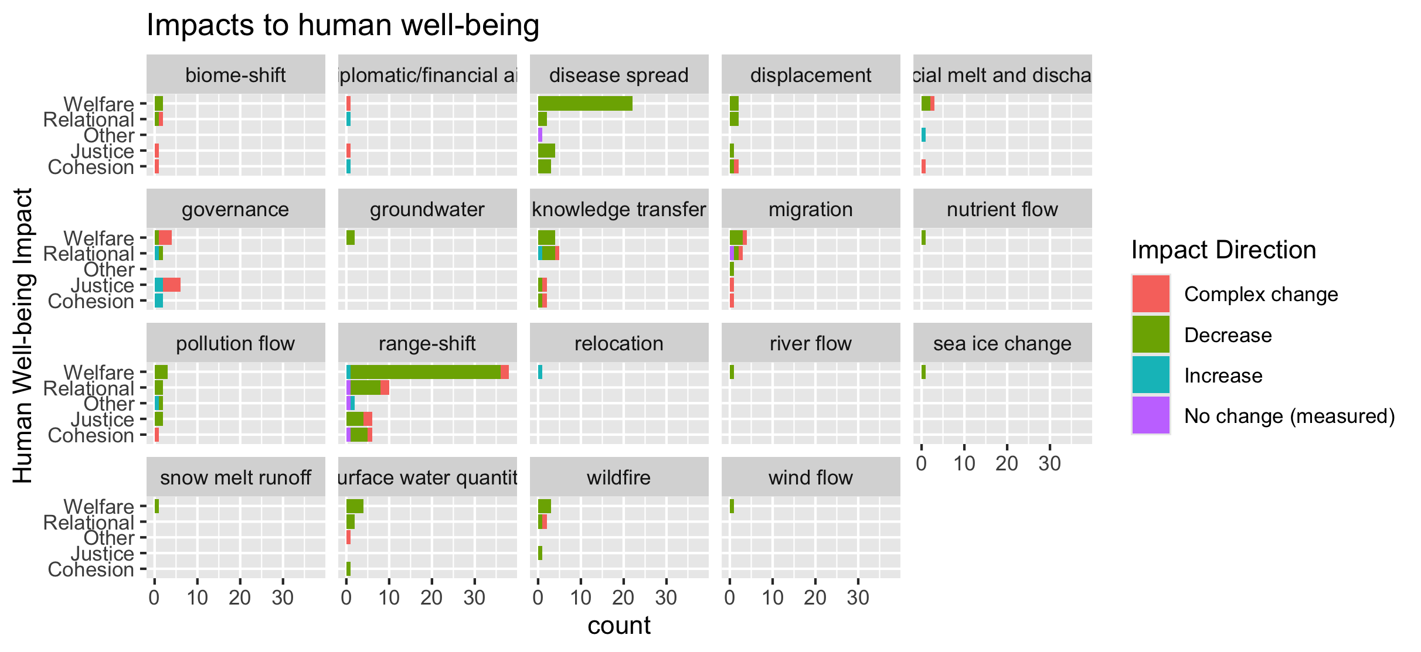
To group physical flow papers

Slide 39
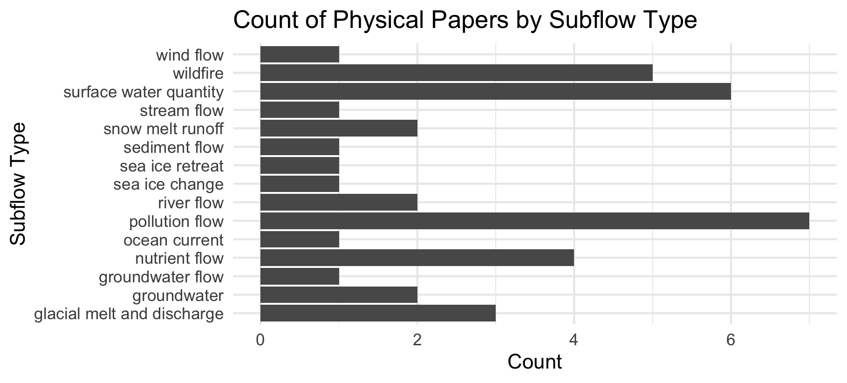

Slide 40
Feb 23 2025

Slide 41
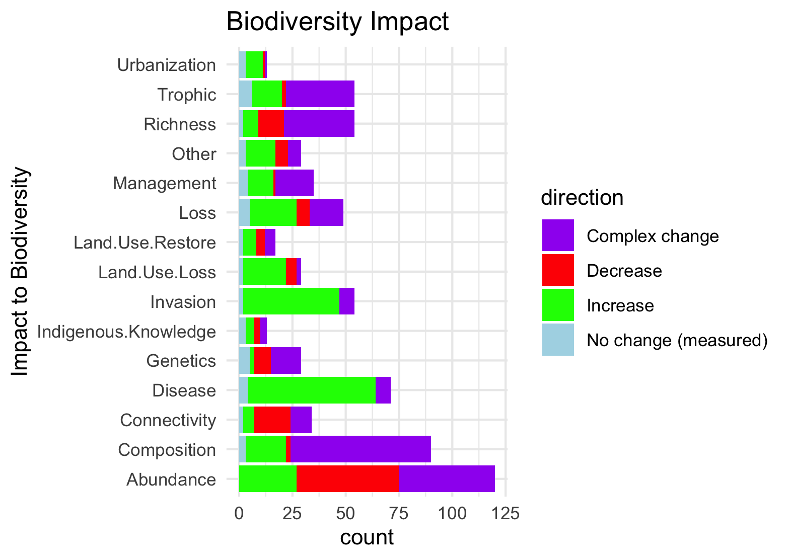
Needs to be grouped by what is good and what is bad to see increase in:

Slide 42
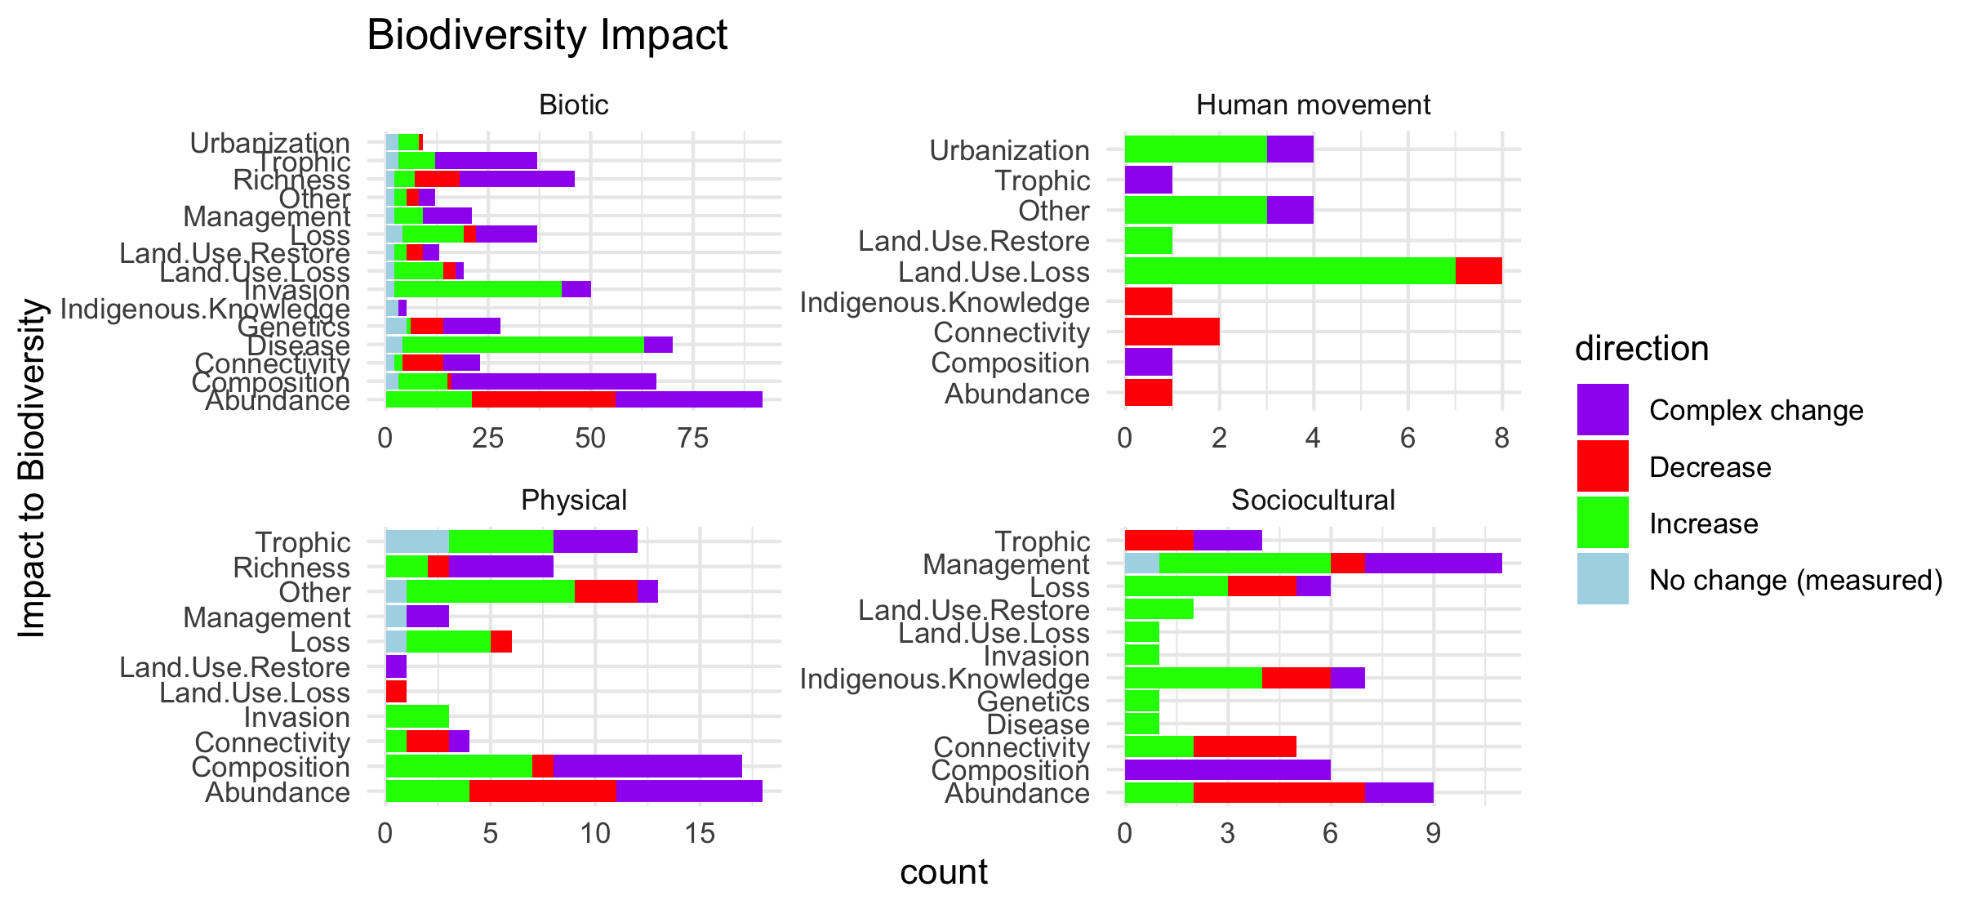
Scale free on the facet (diff x axis)

Slide 43
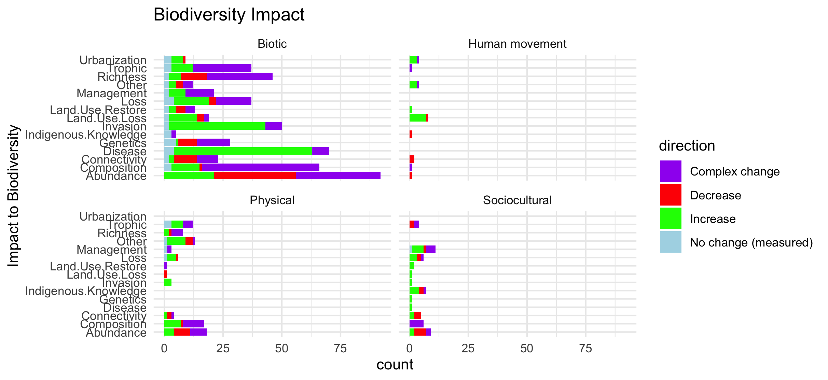
Scale fixed on the facet (same x axis)

Slide 44
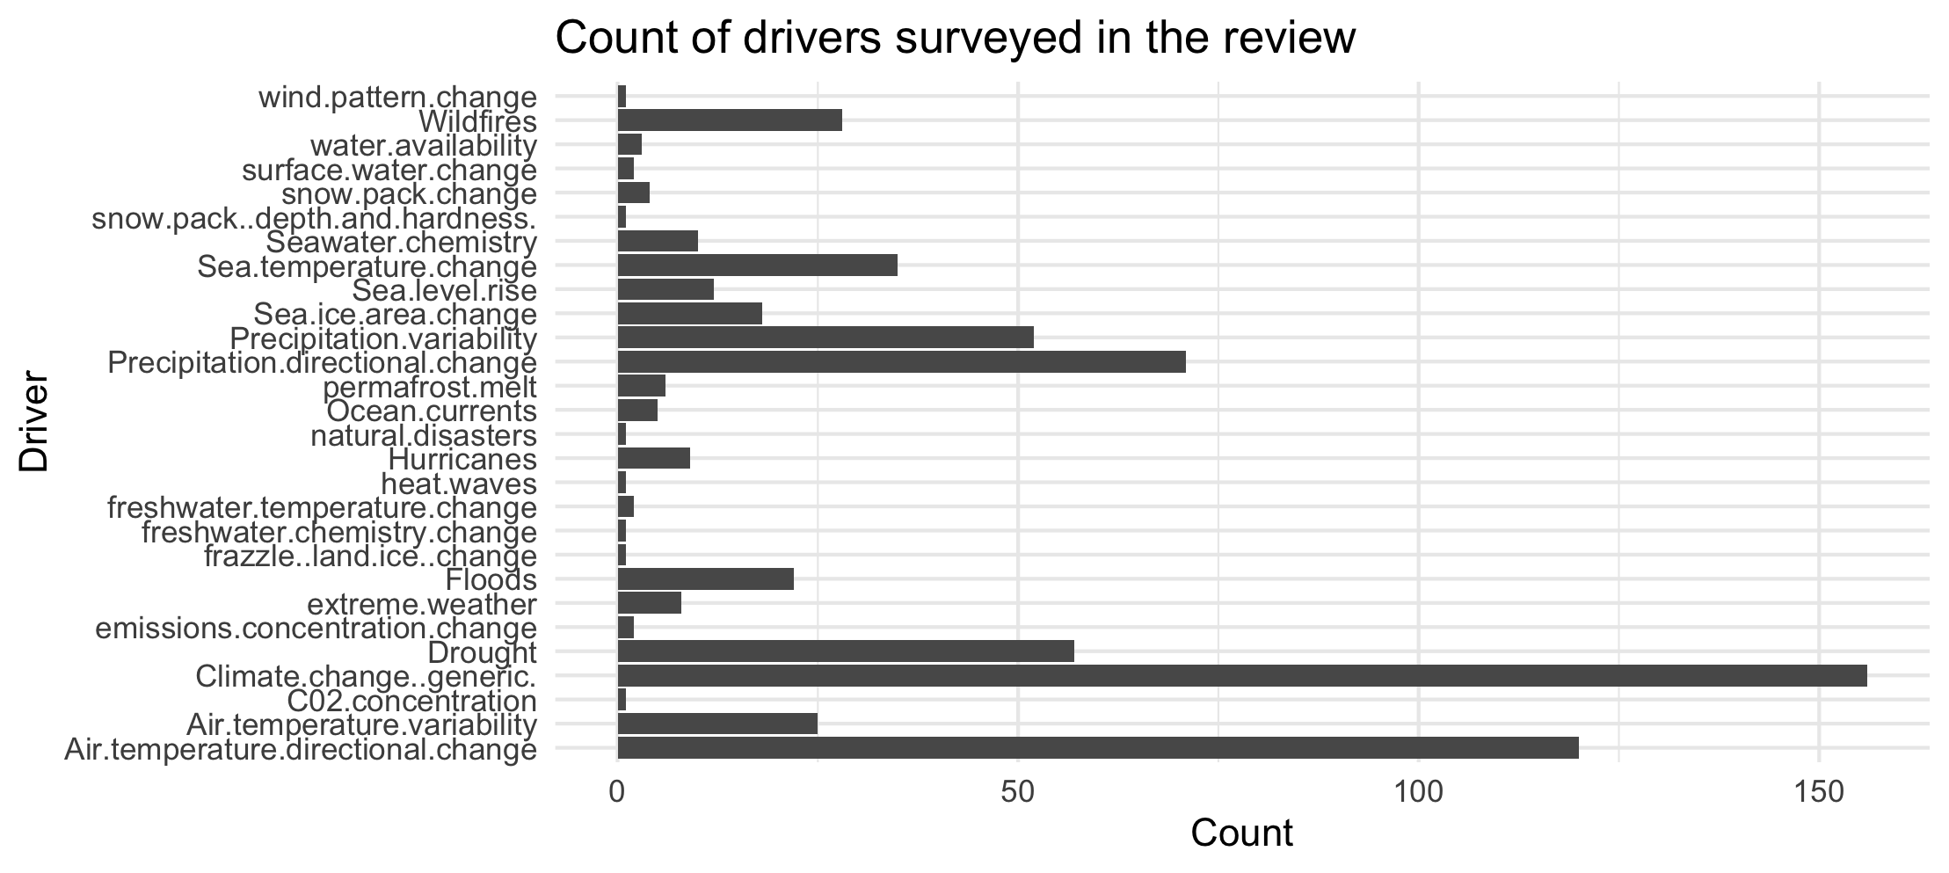

Slide 45
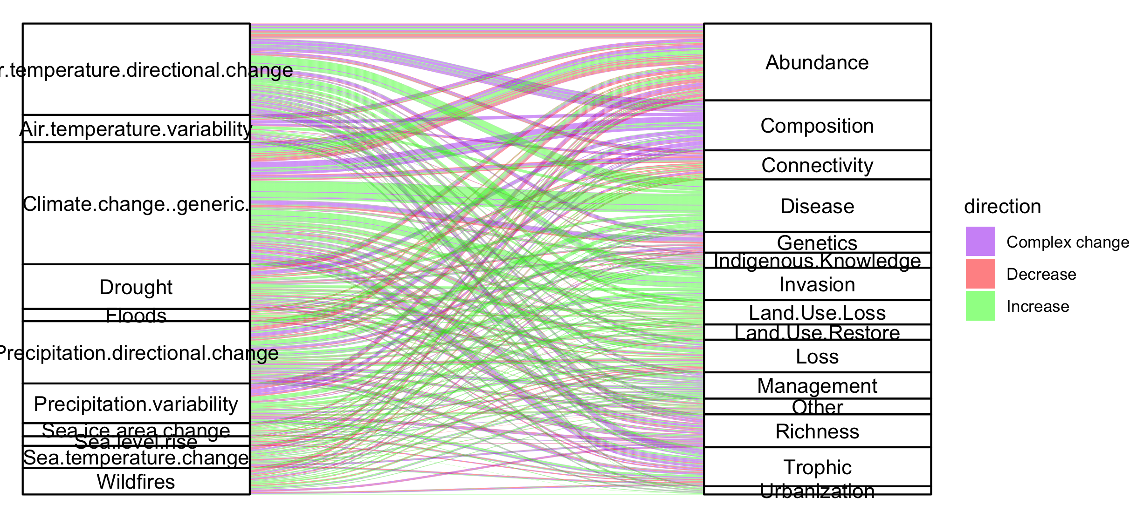
Colleen: see note isn the code – we could group spme of the drivers (hurricaines, extreme weather, ands ome of the ice ones). This still doesnt take into account if changes arw good or bad though and might just be too busy.

Slide 46
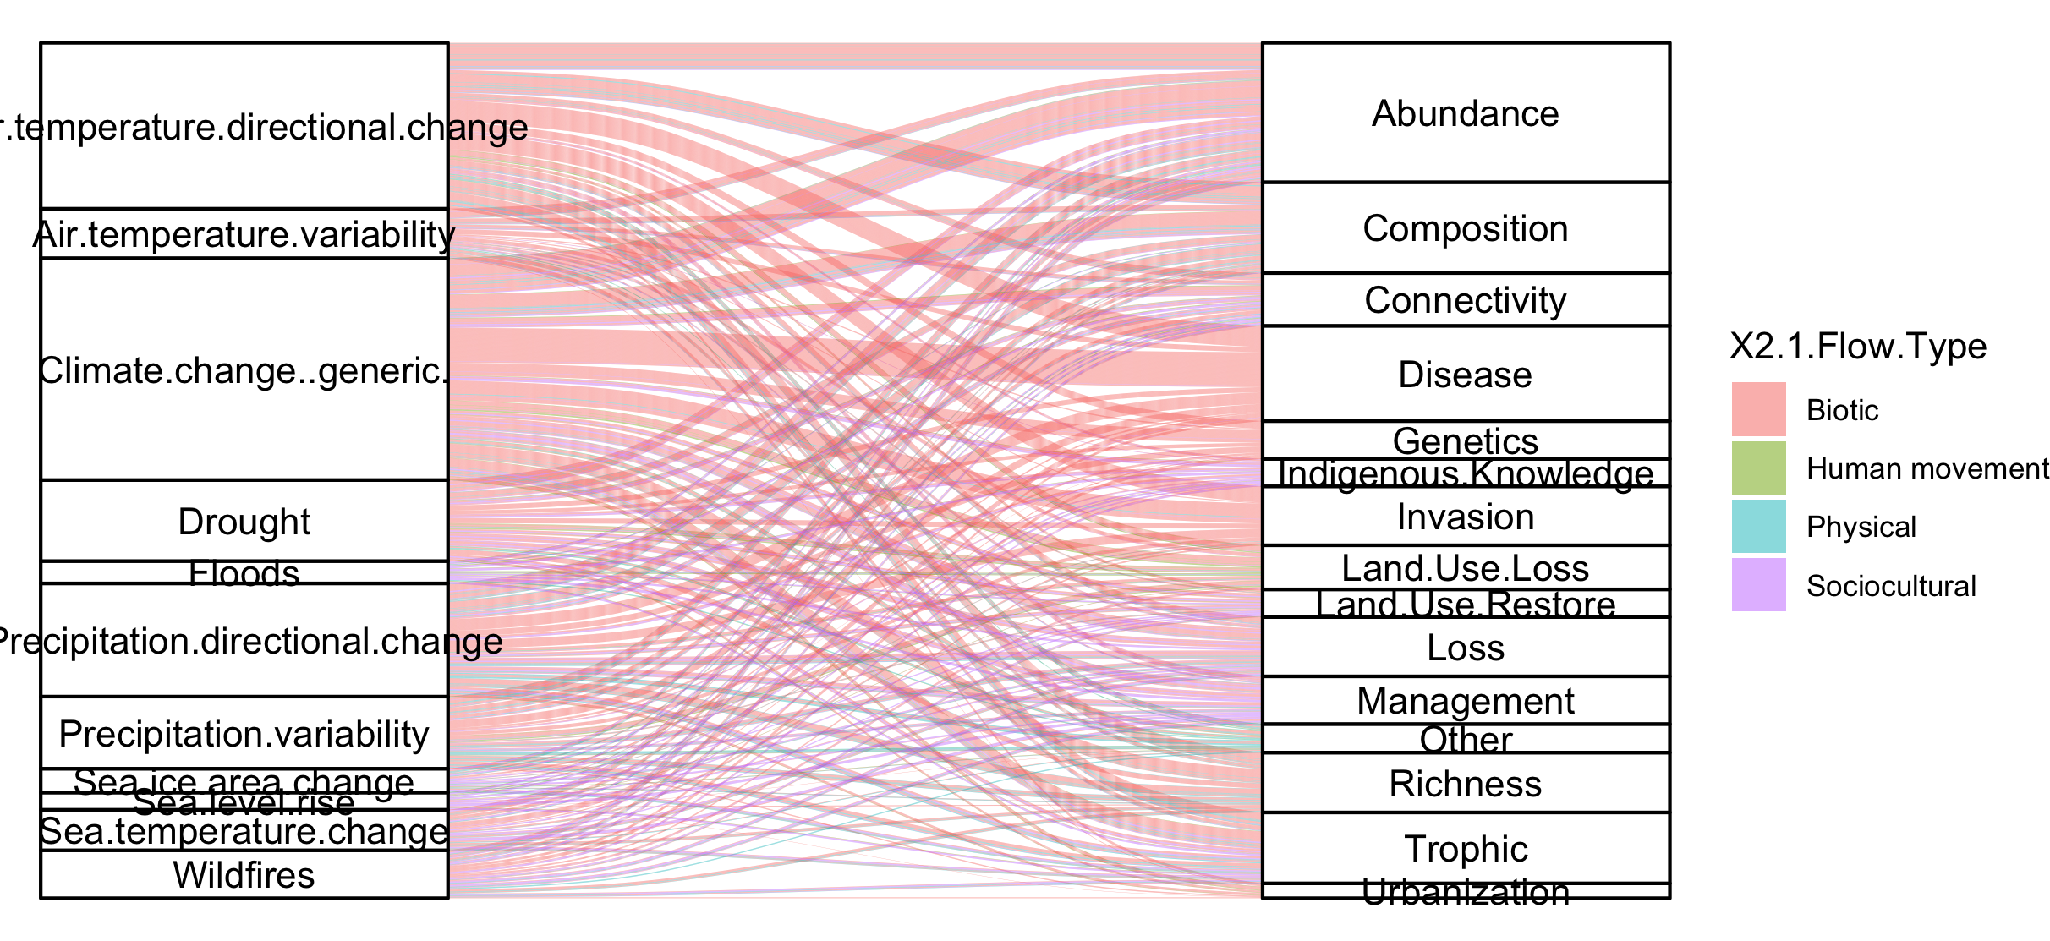
#not that informative because so many more of the papers are biotic

Slide 47
NCPs

Slide 48
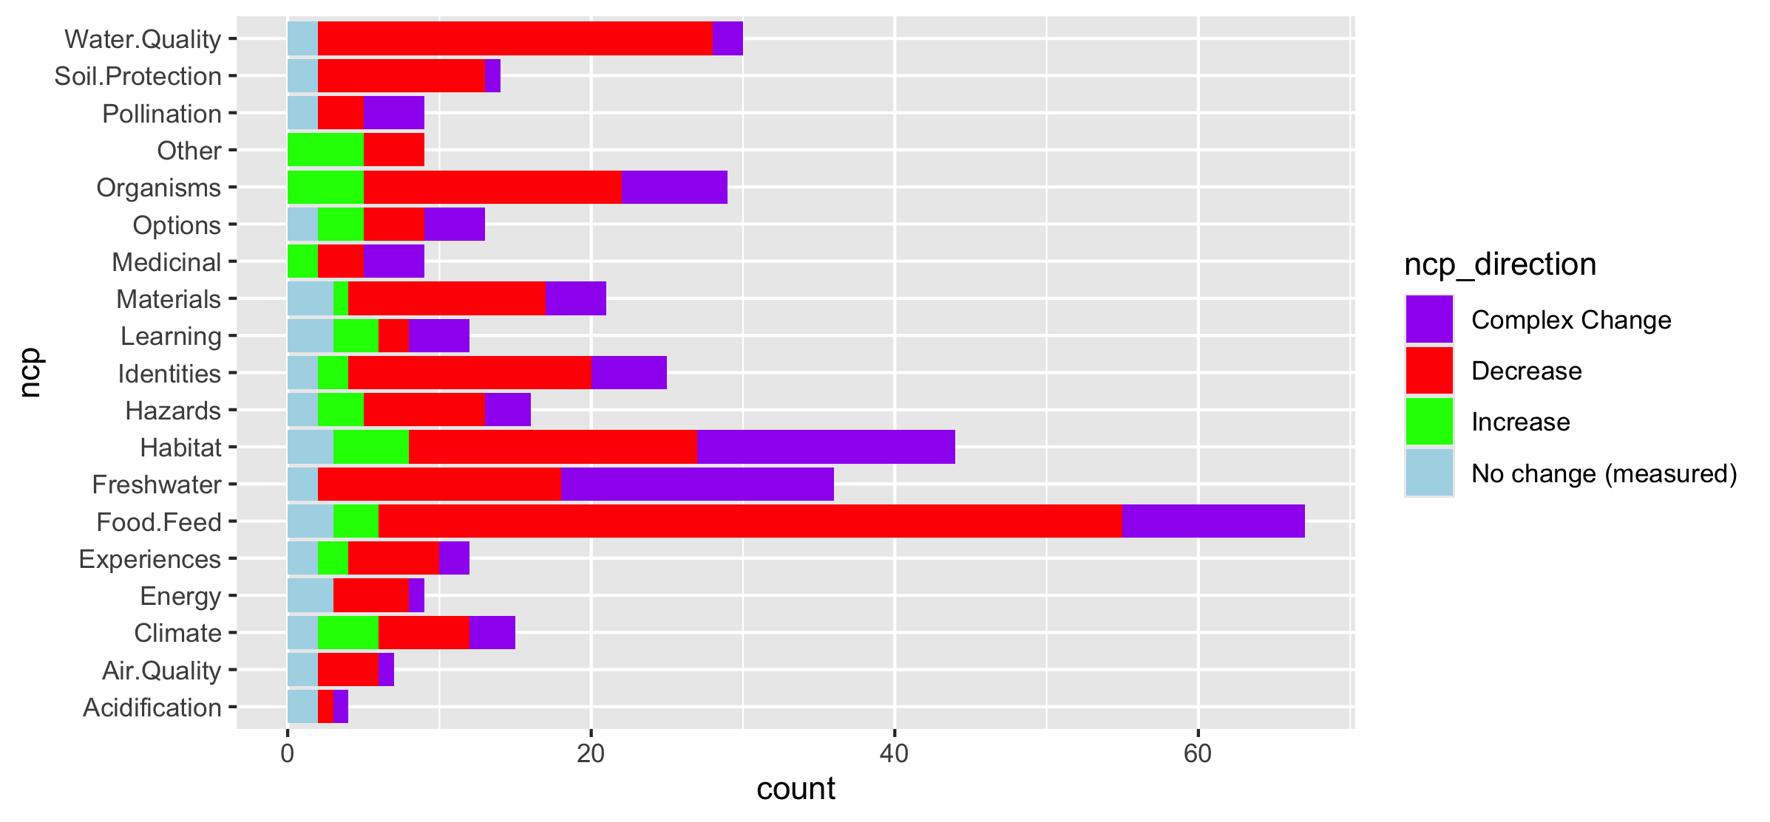
Fix labels

Slide 49
Do by flow type

Slide 50
Fix labels

Slide 51
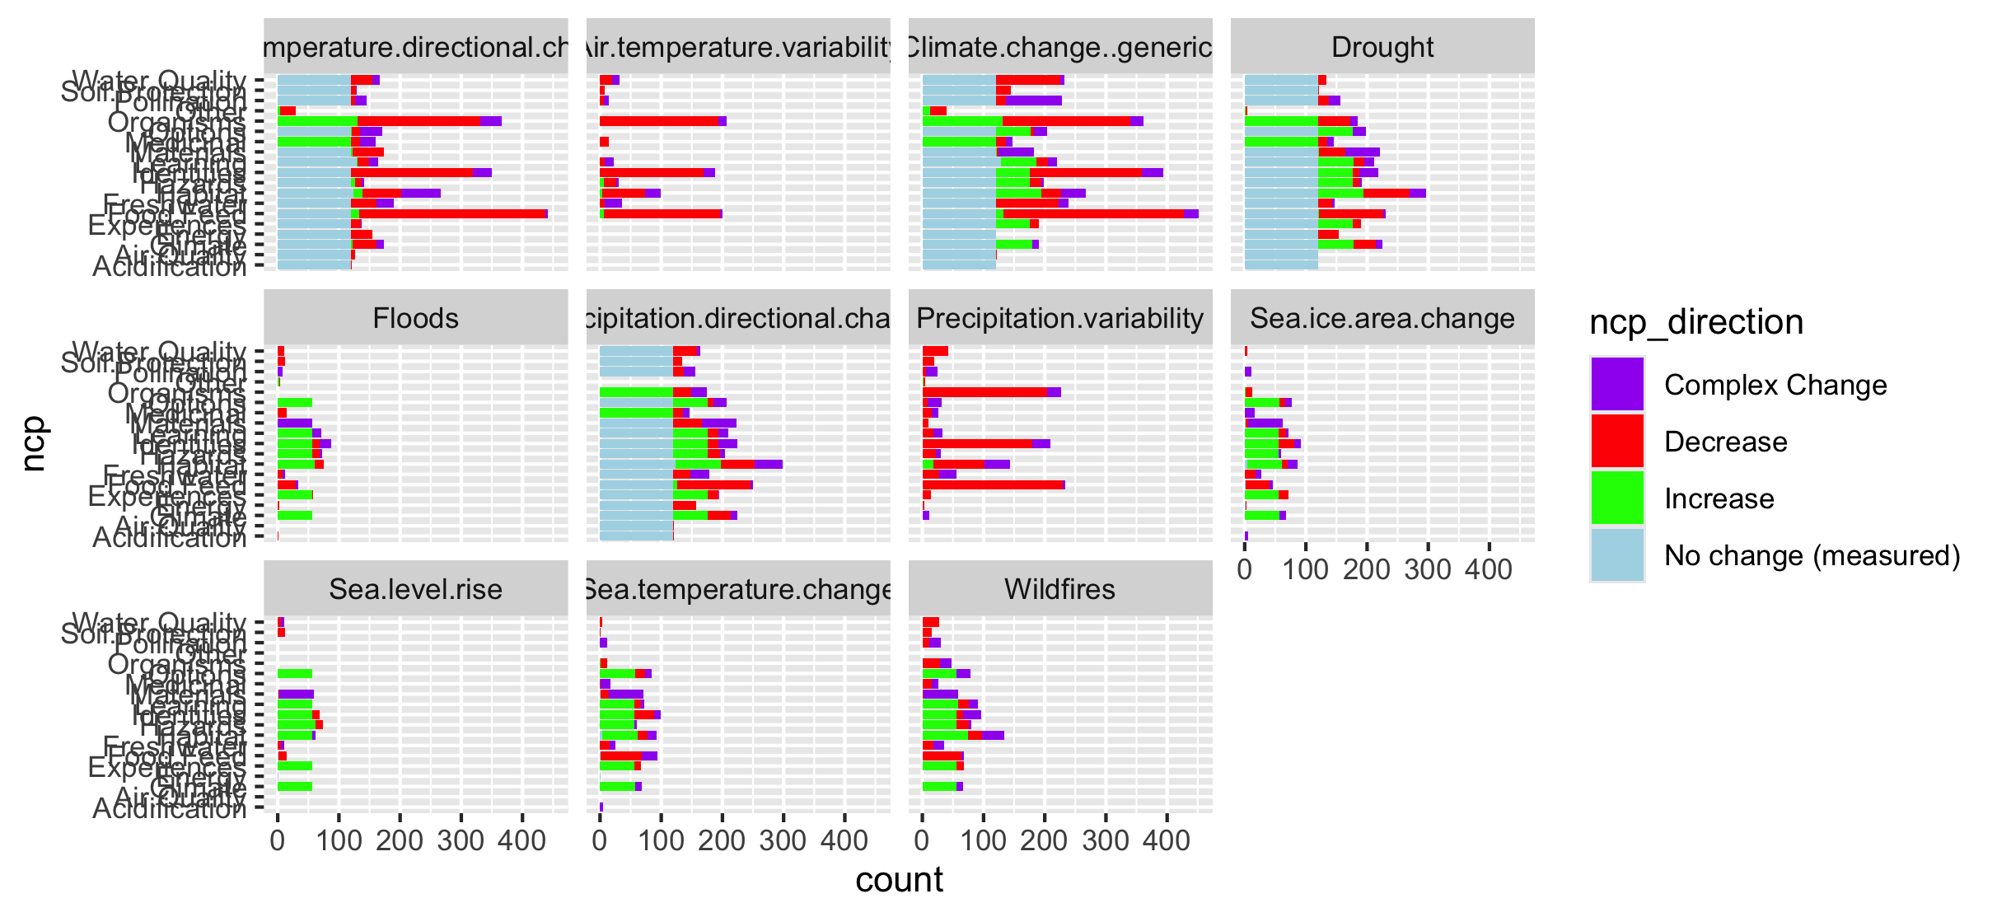

Slide 52
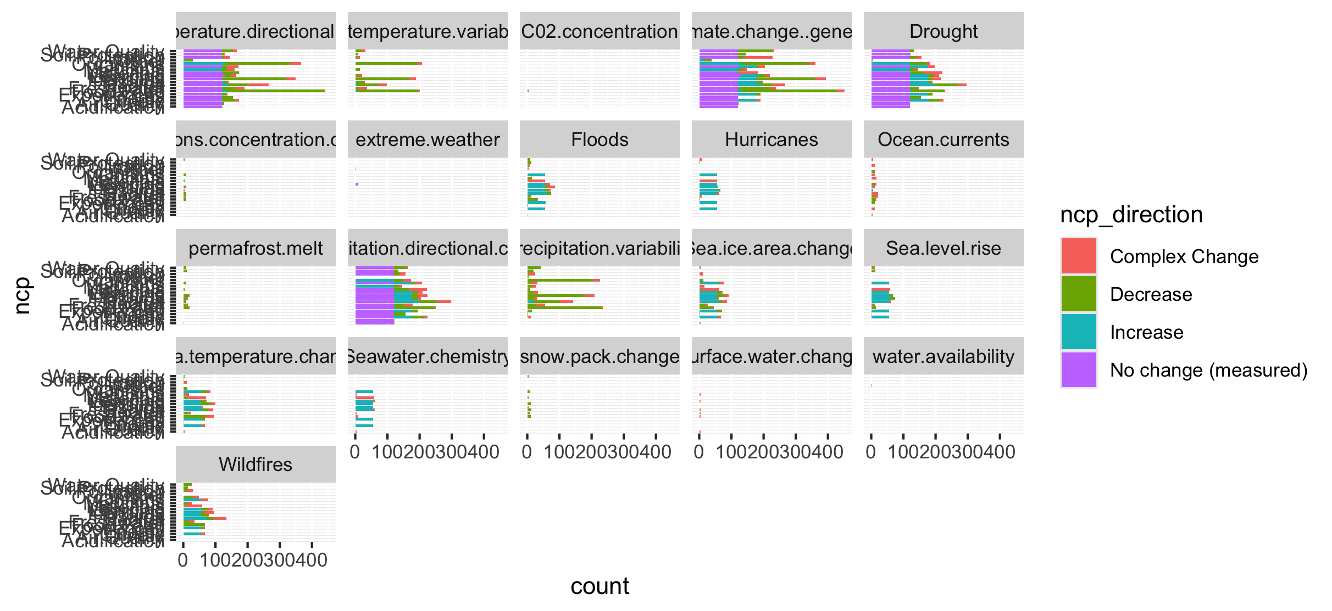
Too many drivers

Slide 53
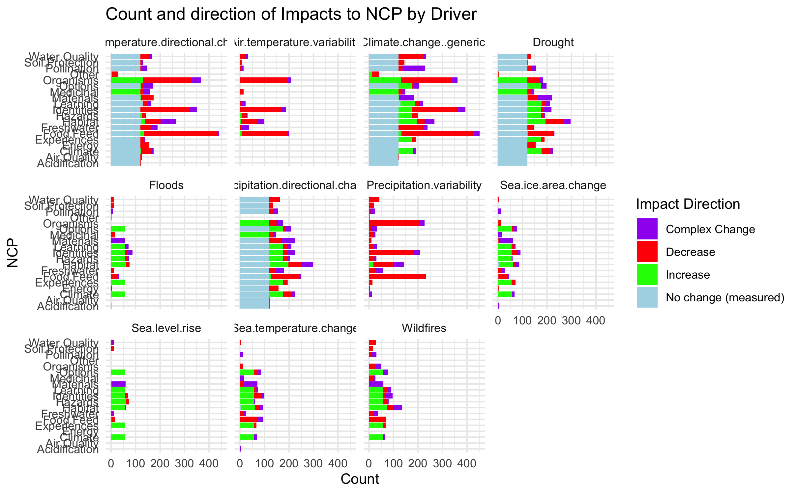

Slide 54
HWB

Slide 55
Connections – how does altered flow relate
Driver~ altered flow (by flow, and subflow – grouped out by flow
Altered flow~ impact (for each category)

